Slide 1

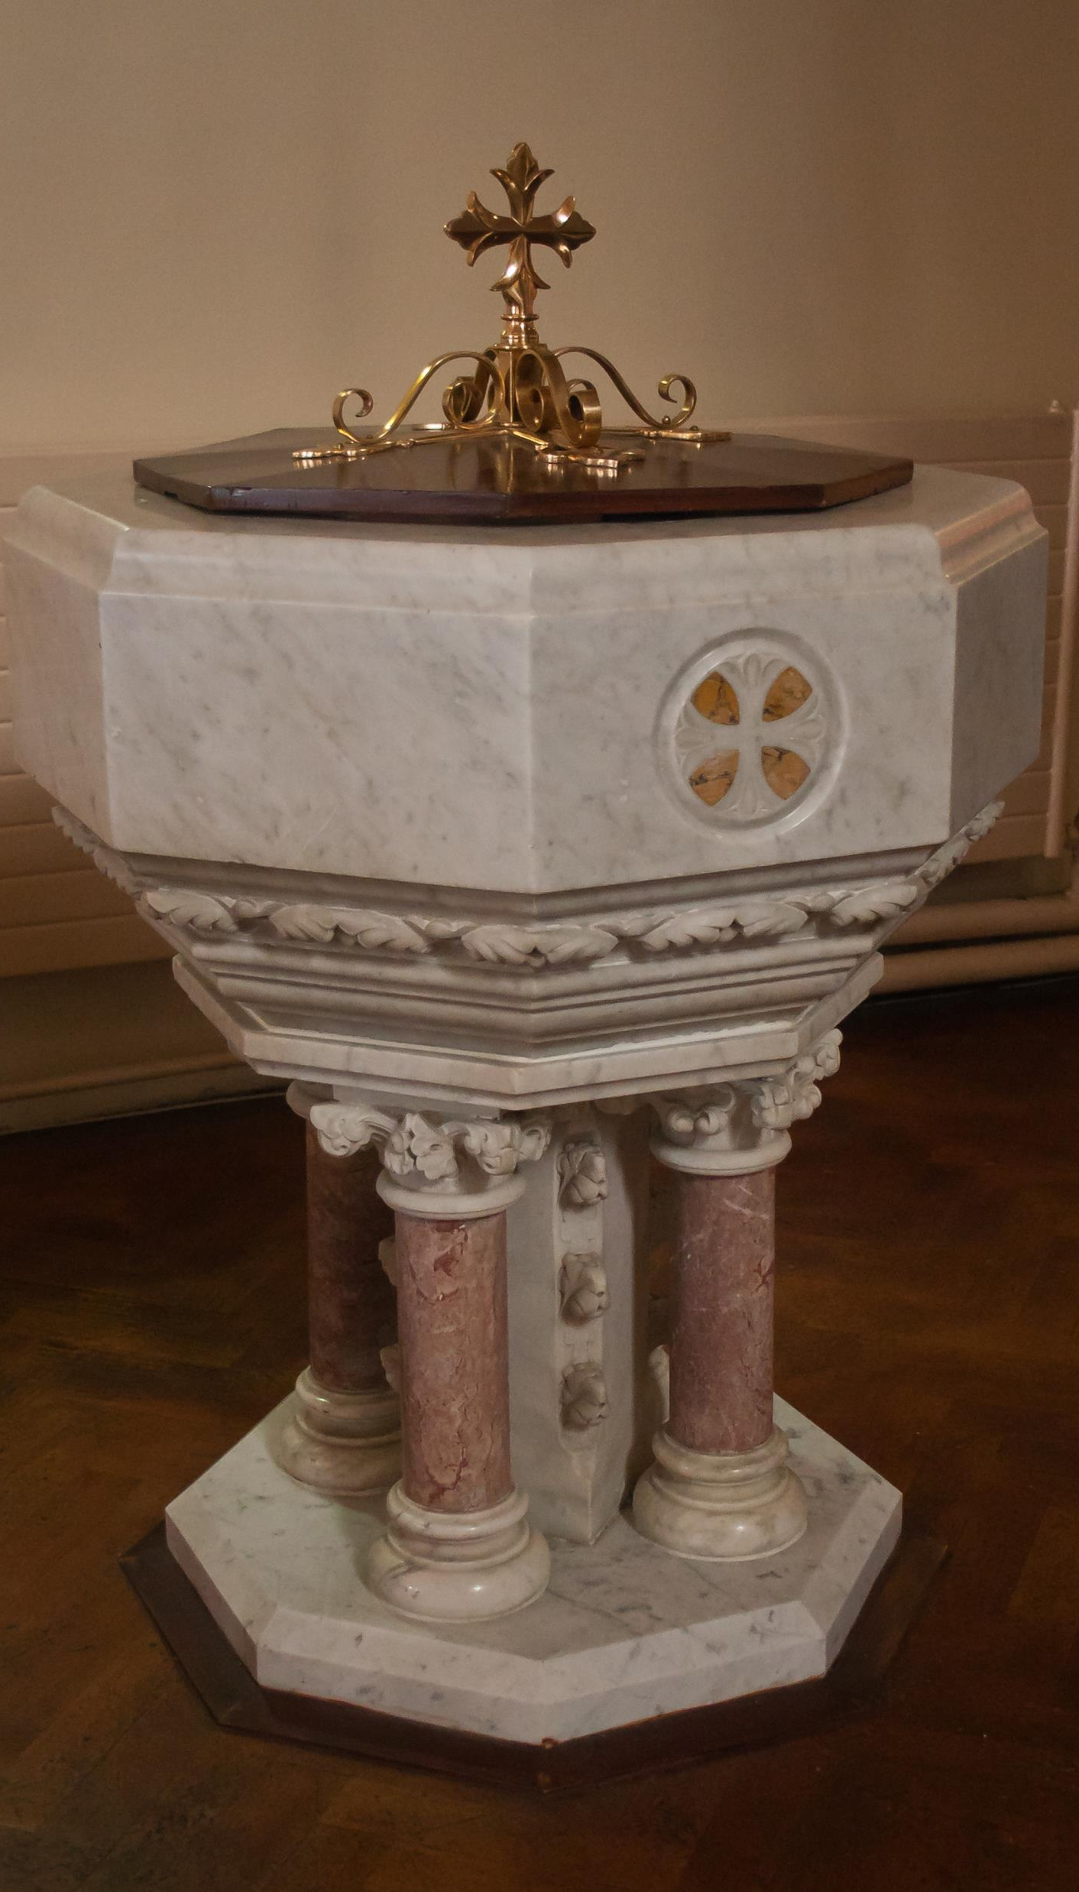

Baptism as The Gateway to Holy Communion
Diocese of Jamaica &
The Cayman Islands
Women’s Auxiliary

Slide 2
Overview Of the Presentation
What is Baptism as the Gateway to Holy Communion
A little history of Baptism and Confirmation
When does this change become effective in the Province of the West Indies
How will this change impact me as a member of my congregation
How can I help others prepare for the change

Slide 3
What is Baptism as the Gateway to Holy Communion?
Baptism as the Gateway to Holy Communion means that persons will be required to be baptized in water and the Holy Trinity before they can receive Holy Communion.

Slide 4
What is Baptism as the Gateway to Holy Communion?
It means that:
Confirmation will no longer be the Gateway to Holy Communion
Persons will no longer be required to be confirmed before they can receive Holy Communion.
They will be required to be baptized in the Trinity, before they can receive the sacrament.

Slide 5
A little History of Baptism and Confirmation
1. At the start of the Christian Church, Baptism was the Gateway to Holy Communion
2. Baptism makes an individual a full member of the church and able to receive the sacrament of Holy Communion

Slide 6
Even Children Received Holy Communion In The Early Church
2nd Century Infants receive Holy Communion in the Western Church
3rd Century Infants receive Holy Communion in Northern Africa
4Th Century Sicily recorded that an eighteen-month-old received the Eucharist and the Fourth Century Apostolic Constitution referred to babes in arms taking the Bread and Wine as well.
7Th Century liturgical text, the ORDOROMANUS XI and a 12th Century Roman pontifical both gave instructions presuming that nursing infants would receive communion. The Gregorian Sacramentary required explicitly that infants be communicated immediately after their baptisms, and Elfric of York ordered his clergy to give newly baptized infants the Eucharist.
(Baptism as the Gateway to Holy Communion Compiled document page 49)

Slide 7
Even Anglicans Gave Children Holy Communion Up To The 18th Century (1700s)
IN ANGLICANISM:
16th and 17th Century – There were debates in England between those who practiced infant baptism and those who insisted on believer’s baptism. Jeremy Taylor even argued that infants should be given both sacraments or none.
18th Century Infant communion was practiced by Non-jurors (One group of Anglicans), as part of their recovery of ancient liturgical practices.
(Baptism as the Gateway to Holy Communion Compiled document page 49)

Slide 8
How Did We Inherit A System Where Children Do Not Generally Receive Holy Communion
The withdrawal of Holy Communion from children happened in stages in the 11th and 12th centuries in the Roman Catholic Church.
It had nothing to do with knowledge or Confirmation.
Reasons:
First: The difficulty experienced by some infants in fully swallowing the consecrated Bread led to the practice of giving infants only the cup.
2. When the practice of giving the laity (lay people) the consecrated wine gradually stopped over the course of the 11th and 12th centuries it had the incidental effect of eliminating the one kind in which infants received. The outcome was that children were now receiving neither Bread nor Wine.
(Baptism as the Gateway to Holy Communion Compiled document page 49)

Slide 9
Add The Age Of Discretion – And We Can See The Some Of The Building Blocks Of Confirmation
13th Century - pious traditions arise about the need to have reached the age of discretion before communion, but this was not the cause of the end of infant communion.
It was the teaching of Thomas Aquinas which influenced the Councils of Florence and Trent and led to the decision. He wrote of aetas perfecta 'perfect age', when the person acquired a certain dignity.
(Baptism as the Gateway to Holy Communion Compiled document pages 49-50)

Slide 10

Yet These Reasons Did Not Lead To Confirmation
Instead, Confirmation was developed to respond to some very practical needs that arose in the worshipping community.

Slide 11
Confirmation As A Sacrament
In the beginning:
Baptism consisted of washing with water, hand laying and anointing with oil.
Baptism was only done by a bishop.
There was no sacrament of Confirmation

Slide 12
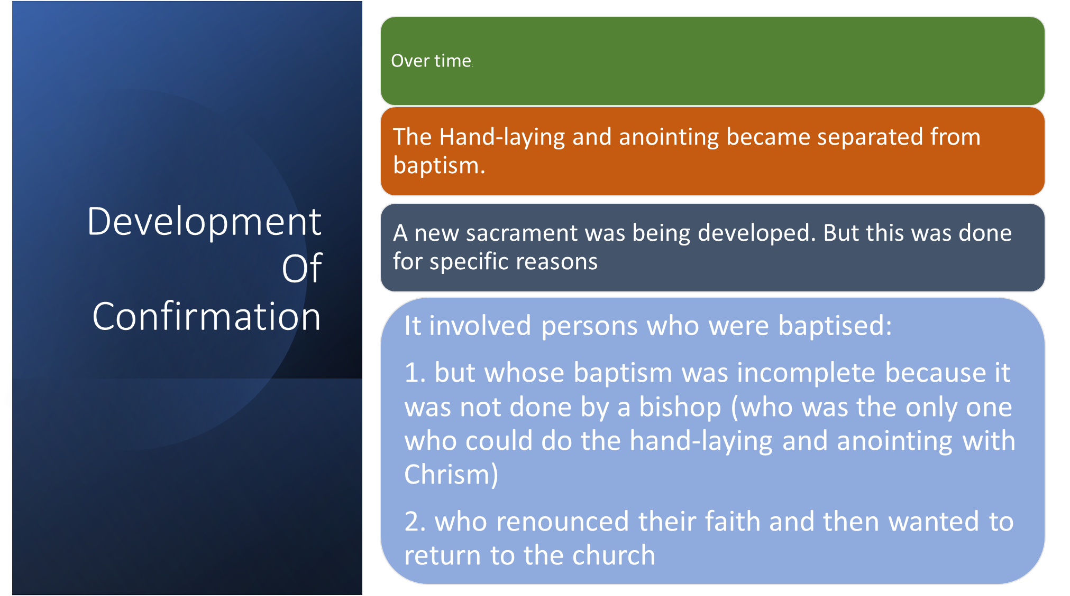

Slide 13
Explanations For The Need For Confirmation (Hand-laying & Anointing)
The Council of Elvira (Spain) about 300, referred to emergency baptism of ailing ship-bound catechumen by a faithful one. If the person recovered, they were to 'be made perfect by the imposition of hands' by the bishop.
The Synod of Arles (314) convened by Constantine to address the issue of rebaptism of heretics, concluded that the individual, questioned about the creed, and being previously baptized using the trinitarian formula should then only have hands laid on them to receive the Holy Spirit.
The Council of Orange (441) made specific reference to confirmation. In the fifth century in Gaul, the confirmation rite involved the imposition of hands. There could also be anointing with oil but only if the priest baptized in the absence of the bishop and the candidate not receiving chrismation.
(Baptism as the Gateway to Holy Communion Compiled document pages 50-51)

Slide 14
But Even With The Development Of Confirmation It Was Not Required For Holy Communion
When Did That Happen And Why?
When John Peckham became Archbishop of Canterbury in the thirteenth century, he wanted to bring the English Church more in line with Rome. To exercise greater control over the congregations, he insisted that no one should receive the Sacrament unless he or she had been confirmed by a bishop. This was a clever means to give bishops more power in the congregations. The bishop had to visit the congregation in order to confirm so that the people could receive the sacrament.

Slide 15
The When and Why of Confirmation
But as Charles P. Price points out in an issue of Occasional Papers, published by the Standing Liturgical Commission, the good bishop’s intent was to encourage confirmation by his bishops and not to exclude persons from the communion.
Joseph P. Russell and Jane L. Weaver, Children in the Eucharist (Education for Mission and Ministry, Episcopal Church Center, 1990), 7.
(Baptism as the Gateway to Holy Communion Compiled document page 51)

Slide 16
Return To The Early Church Practice Of Baptism As The Gateway To Holy Communion
The Church in the Province of the West Indies, of which we are members, is returning to the Early Church practice of Baptism as the Gateway to Holy Communion
So that all persons who are made members of the church by baptism, both adults and children, can be nurtured at the Lord’s Table and grow in faith.
The sacrament of Holy Communion is not a reward for those who have gone through the process of Confirmation preparation.
It is a gift of grace from God to the members of the church, therefore, we do not need to qualify ourselves to receive this gift.

Slide 17
When Does This Change Become Effective In The Province Of The West Indies?
The Provincial Synod of 2022 agreed that the transition from Confirmation as the Gateway to Communion to Baptism as the Gateway to Communion will take effect on Advent Sunday, the 3rd day of December, 2023

Slide 18
How Will This Change Impact Me As A Member Of My Congregation
You will gradually see children, and persons from other denominations who are baptised (in the Trinity) coming for Holy Communion
You should see greater emphasis on understanding what Baptism means. Baptism is a complete sacrament that makes each person a full member of the church. But Baptism comes with responsibilities. We will all need to assess if we are living up to our baptismal commitments.
You should see more teaching about the Faith of The Church as laid out in the Catechism
You should see greater emphasis on the preparation of parents and God-parents for the baptism of children. This is to ensure that they know the Christian faith and can teach the child how to live and grow as a Christian.
You will see Confirmation shift to become a sacrament offered only to adults (persons over 18 years of age) who want to make a public affirmation of their baptismal faith – which is the core of what Confirmation is.

Slide 19
How Can You Help?
You can pray for your church, the Diocese of Jamaica & The Cayman Islands, and the Dioceses that make up the Church in The Province of the West Indies, as we prepare ourselves for this change.

Slide 20
How Can You Help?
Share
You can share the correct information about the change that will occur in the Province, so that others can prepare themselves
Ask
You can ask more questions of your Priest, Dean, Archdeacon and Bishops to ensure that you are clear about this change
Ask
You can ask your Priest or Dean for more teaching about Baptism, Holy Communion and Confirmation

Slide 21
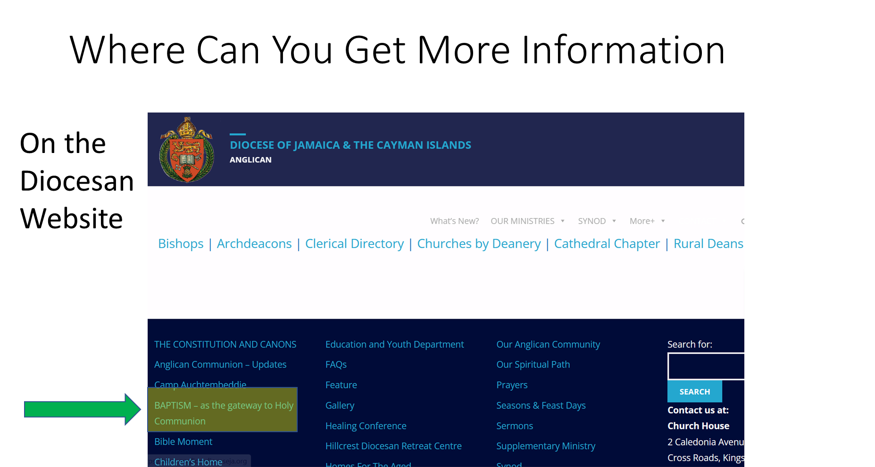

Slide 22
How Can You Help?
You can be a source of encouragement for families with children, helping to teach them the Christian faith, and providing a loving, nurturing environment in the congregation so that they will want to make your church the place where they will grow up in faith
If you are baptised and confirmed, you can offer support and encouragement to those persons who are not yet baptised or who are thinking about Confirmation. You may share your faith story and offer prayers and words of encouragement to help others make their decision

Slide 23

Questions

Slide 24
Baptism as The Gateway to Holy Communion
Diocese of Jamaica &
The Cayman Islands
Women’s Auxiliary

