Slide 1
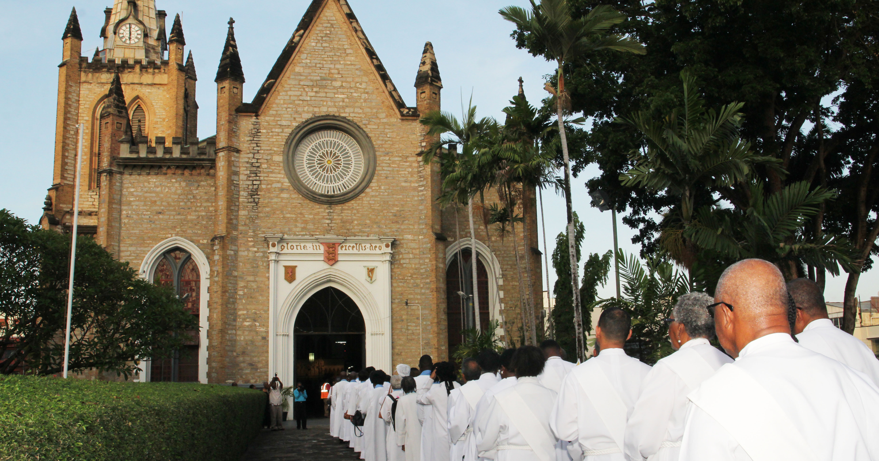
Theme: Being Disciples in Our Caribbean Context
Called: Empowered: Sent
Anglican Synod
May 28, 2019

Slide 2
TABLE OF CONTENTS
Discipleship – The Mandate (Strategic Focus: ‘Intentional Discipleship -- 2016)
Visioning Discipleship – ‘Thy Kingdom Come’
The Mission of Discipleship -- Called: Empowered: Sent -- 5 Thematic Issues
Caribbean Context… Economy, Society, Polity
Getting Our Priorities: in light of Discipleship Mandate, Vision, and Context -- Focusing Our Priorities
Readying Ourselves for Discipleship – Key Success Factors (Transformational Leadership; Commitment Planning)

Slide 3

The Mandate (Calling) for Discipleship –
The Five Marks of Mission (p. 3)
To proclaim the Good News of the Kingdom.
To teach, baptize and nurture new believers.
To respond to human need in loving service.
To seek to transform unjust structures of society, to challenge violence of every kind and to pursue peace and reconciliation.
To strive to safeguard the integrity of creation and sustain and renew the life of the earth.

Slide 4
The Mandate for Discipleship

Slide 5
A learning process by which a believer becomes more and more like Christ.
It is the Christcentric path to spiritual growth. (Paul J. Bucknell)
  "So that you may walk in a manner worthy of the Lord, to please [Him] in all respects, bearing fruit in every good work and increasing in the knowledge of God." Colossians 1:10
Defining Discipleship

Slide 6
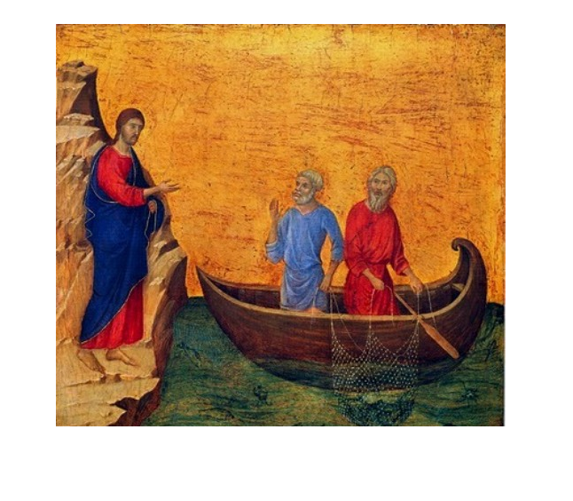
The Image of Discipleship
Paul (2 Cor 5.17):
  ‘So if anyone is in Christ, there is a new creation: everything old has passed away; see, everything has become new!’

Slide 7
Discipleship
A lifelong, whole-life reorientation which will have challenging implications for our self-identity, our belonging within community, our belief systems, and our daily behaviour.
Source: The Anglican Consultative Council London, 2016

Slide 8
Intentional Discipleship
Disciple of the Gospel of Christ – each to learn to master and to articulate the whole Gospel.
Disciple of the Word of God – each to learn to read the Bible and to feed himself spiritually.
Disciple of the Life of Prayer – each to learn to pray and to listen to God through contemplation and spiritual disciplines.
Disciple of Service – each to offer some months or years to serve God in a certain capacity within the Church or society. (e) Disciple of Mission – each to make at least one mission trip per annum outside his comfort zone.
Source: Intentional Discipleship and Disciple-Making: An Anglican Guide for Christian Life and Formation (2016:23)

Slide 9
As the Disciples of Jesus found out along the way, the Calling is not an easy path.
  Peter discovered on his journey up to Jerusalem that the road ahead was not always clear.
  James and John discovered there were temptations of power and influence.
  Judas became compromised.
Anglican Archbishop of the Province of South East Asia -- The Challenge

Slide 10

The Call to Discipleship

Slide 11
The Great Commission
(Discipleship as a Way of Life)
Jesus commands us to:
  “Go and make disciples of all nations, baptizing them in the name of the Father and of the Son and of the Holy Spirit, and teaching them to obey everything I have commanded you.” (Matthew 28:19-20)
Creation of the Discipleship Ministry!

Slide 12
The Great Commission
As together we go on following the ways of Jesus we discover, with Paul, that our life becomes less and less our own and increasingly ‘hidden with Christ in God’ (Col 3.3).
In stark contrast to the individualism that plagues much of our contemporary society, we find ourselves becoming part of something (someone) much greater, much more beautiful and fulfilling – Christcentric!.
But this experience of true humanity ‘in God’ is not something to hold to ourselves. It is for all humanity, indeed for all creation (Roman, 8.19).

Slide 13
THE CALLING: The Sermon on the Mount
The poor in spirit are those who have accepted the loss of all things including their own selves for his sake
Those who hunger and thirst for righteousness are those renouncing all claims to personal achievement, who wait for God’s reign of righteousness
The merciful, having given up claims to their own dignity, become "men for others," helping the needy, sick, castouts — all those who need any kind of ministry.
Pure in heart become that way by giving their hearts completely to the reign of Jesus.
Peacemakers renounce all violence and "maintain fellowship where others would break it off."

Slide 14
Bonhoeffer’s exposition of the Sermon on the Mount, he gives an exposition of Matthew 9:35-10:42
The Harvest (the people are without a shepherd, without relief, deliverance, and forgiveness) for which one must pray for laborers;
The Call of the Apostles (who are given power stronger than Satan’s and are bound together only by their choice and call);
The Work (fulfilling their commission to preach, traveling as messengers of the King, living in "royal poverty," warning men of the urgency of the times);
The Suffering of the messengers (as Jesus was persecuted so the messengers will be, but they are forewarned
The Harvest is Ripe: the Labourers are Few…

Slide 15

BEING CALLED
The Societal Context: Global, Regional, National

Slide 16

The Call to Strengthen Faith in Action - Global
The 17 Sustainable Development Goals (SDGs) are an urgent call for action by all countries (developed and developing) in a global partnership.
The 2030 Agenda for Sustainable Development adopted by all United Nations Member States 2015, provides a shared blueprint for peace and prosperity for people and the planet, now and into the future

Slide 17
The Call to Strengthen Faith in Action - Regional
The Strategic Plan for the CARICOM envisages a Caribbean Community that:
  Is integrated, inclusive and resilient; driven by knowledge, excellence, innovation and productivity.
  Where every citizen is secure and has the opportunity to realise his or her potential with guaranteed human rights and social justice.
  Contributes to, and shares in, its economic, social and cultural prosperity.
  Is a unified and competitive force in the global arena.

Slide 18
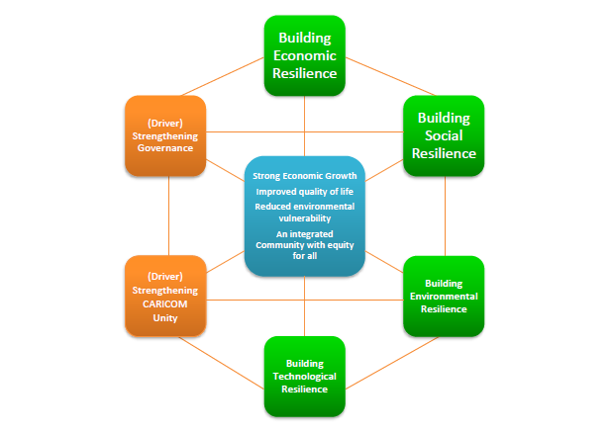
Six-point strategy for building social, economic, environmental and technological resilience of Member States to 2019 and beyond
.

Slide 19
Goal -- Putting People First: Nurturing Our Greatest Asset.
  “All our citizens, particularly the most vulnerable, must be loved and cared for and treated with dignity and respect. We must create a society in which all the basic needs of the people are met and each individual is given an opportunity to contribute and to self-actualize. (Community & Worship)
  This means that we must eradicate poverty, discrimination, economic and social marginalization, disease and poor 45 health and substandard living conditions.
  We should provide a nurturing environment that teaches, promotes and richly reinforces behaviours and skills needed to create productive citizens. (Stewardship & Worship)
  We must build a society that shares the social attributes and cultural norms of trust, goodwill, honesty, respect, tolerance, integrity, benevolence and civic pride, social justice and community spirit”. (Worship, Community and Stewardship)
The Call to Strengthen Faith in Action – National (Trinidad and Tobago)
National Development Strategy 2016 – 2030: Vision 2030

Slide 20

Vision 2030
Goal I: People First: Nurturing Our Greatest Asset
Goal II: Good Governance and Service Excellence
Goal III: Quality Infrastructure and Transport
Goal IV: Building Globally Competitive Businesses
Goal V: Valuing and Enhancing Our Environment

Slide 21

Being Empowered
Vision for Discipleship
(The End State; the Destination)
Mission/Core Values
(The Journey; the Means to Get to the Destination as Vision Realized)

Slide 22

Being Sent
Christcentric Discipleship - Liturgy (Worship); Social Dialoging; Community; Stewardship

Slide 23
The Essence of Discipleship
When God is the center of our lives, we live to please Him.
When we please God, we want Him to influence each area of our lives.
We then use our God given skills in the service others in the home, community and society

Slide 24
Spiritual/Temporal Values of Discipleship
Love
Faithfulness
Integrity
Worship
Communication
Reconciliation
Source: Strategic Plan 2016 – 2020: Anglican Diocese of Trinidad & Tobago

Slide 25
Elements of Discipleship
Teaching the basics of faith and assurance of salvation.
Understanding the dynamics of discipleship.
Achieving a confidence in apostolic and Biblical teaching.
Growing in faith and Christian practice.
Becoming skilled in sharing one's faith and leading others in discipleship. Beginning to define one's life calling and clarifying one's spiritual gifts.
Finding one's place in the Body of Christ-not only in evangelization, but in fellowship, in worship, and in service.

Slide 26
Plan of Action for
The Anglican Church in the Province of the West Indies
2015 - 2018

Slide 27
Discipleship in Action – Mission Critical Activities
Liturgy (worship – celebrating the Risen Christ)
Social Dialoguing (engaging each other in matters of faith)
Community (social responsibility to home, community and nation)
Stewardship (‘manager of God’s affairs on earth’ -- using spiritual, financial, and other resources to build the Church and community -- Anglicanism)
Source: survey of mandate of religious communities, UK; Australia

Slide 28
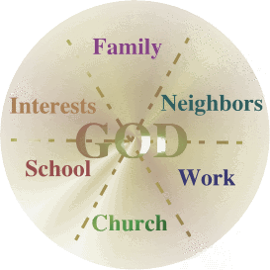
Arenas for Carrying Out the Christcentric Mission
Paul J. Bucknell

Slide 29
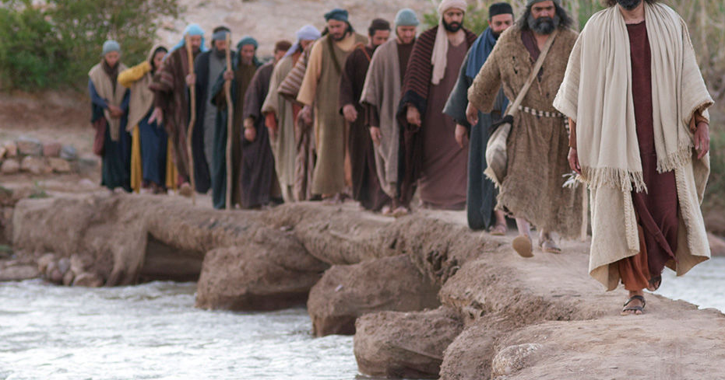
Being Sent:
Being Sent: Christcentric Discipleship – Liturgy (Worship); Social Dialoging; Community; Stewardship

Slide 30
Equipping our Youth for Discipleship
Discipleship within the Family
Discipleship within a Multicultural Society
Discipleship in an Era of Moral Indifference
The Church’s Role in Developing Models for Christian Discipleship
In the Vineyard of Intentional Discipleship
(The Five Thematic Issues)

Slide 31
Beyond a token “Youth Sunday” participatory LSSC Management of the Affairs of the Church.
Youth involvement as ushers, choristers, music volunteers, scripture readers, teaching Sunday School…
David Wright
Equipping our Youth for Discipleship -
Building the Church’s Talent Pipeline/ Succession Planning

Slide 32
Equipping our Youth for Discipleship -
Building the Church’s Talent Pipeline/ Succession Planning
Programmes at denominationally run schools and in partnership with interdenominational Christian organizations with a focus on equipping students for Christian life, for Discipleship Ministry and leadership within public institutions and beyond.
The intention is to bring up maturing believers who are Spirit-led and LSSC Christ centred in life, mission, and purpose

Slide 33
Discipleship within the Family
Train up a Child in the way he/she should go…
Based on Core Values in the 2015-2020 Strategic Plan
Enhancing family life – widely recognized as being in need of strengthening
Anglican Church Training and Employment Mission (ACTEM) – has expanded the scope of the committee to include interview training, resume writing and preparation for the world of work; and handling job loss.
Parenting Programs (Train the Trainers) – Children’s Home (Community)
Social Outreach – preventing and mitigating GBV; Food Bank; Homework Centres; Walkathons (Community)
Prayer and Spirituality Committee – Bible Festival (Liturgy/Social Dialoguing)
Mothers’ Union Looking, Observing and Acting (MULOA) (Stewardship)
‘The Provincial Link’ (new publication)

Slide 34

Discipleship within a Multicultural Society
“Reaching out to others and ministering in a multicultural society" as an essential to Intentional Discipleship.

Slide 35
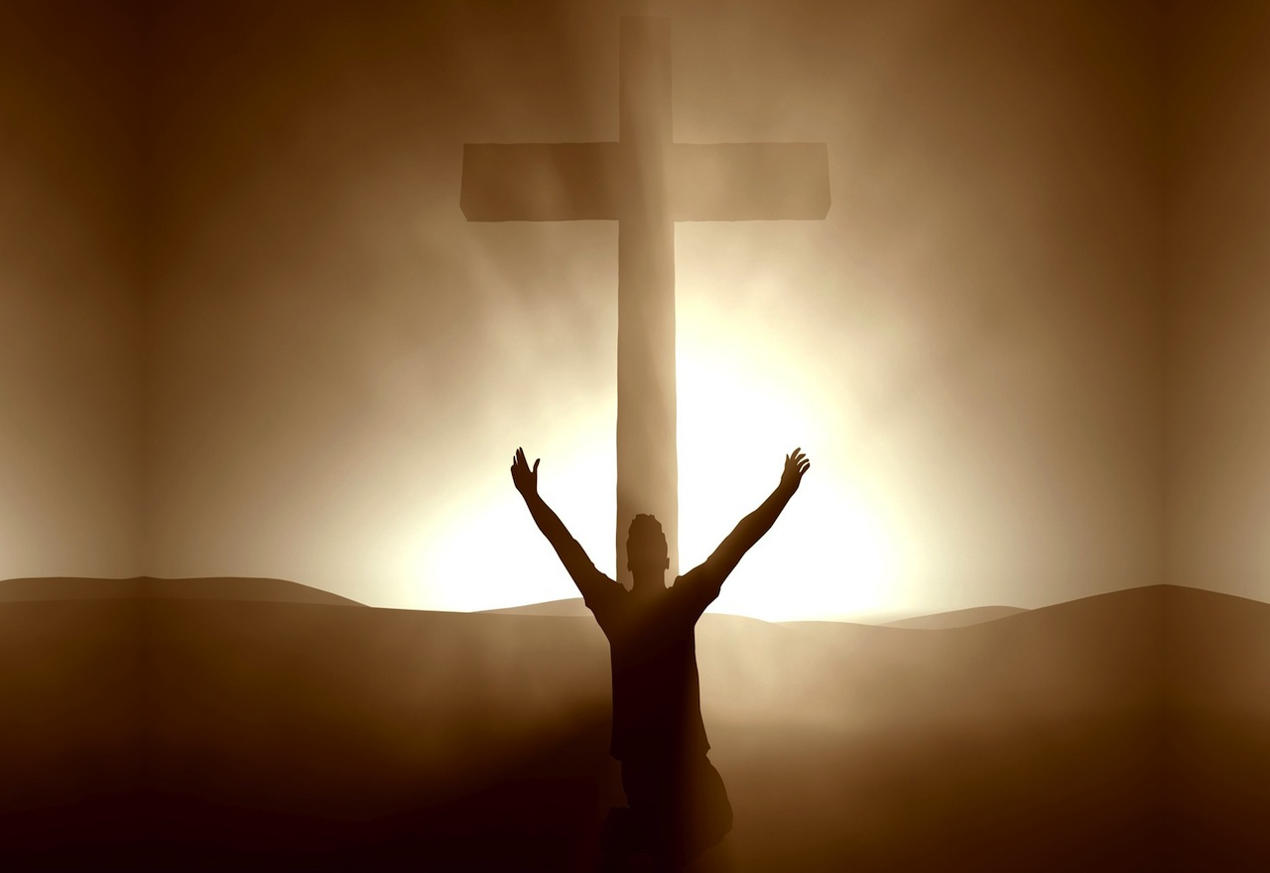
Implementing Intentional Discipleship
The Church’s Guidelines

Slide 36
All leaders must embrace behaviours, core values and principled actions such as:
  Commitment to the Theological and Doctrinal underpinnings of Anglicanism.
  A planned, orderly and supported process of transformation to a culture and ethos of collaboration.
  Development and enhancement of ICT systems.
  Commitment to Christian Stewardship to the Marks of Mission.
  Strengthening of the financial and interactive media to improve efficiency and sound decision-making.
Enabling Environment - Christcentric Leadership

Slide 37
Enabling Environment - Christcentric Leadership
‘Let us yield, as we journey, to the authority and perfect example of our Lord, who has called us to be tireless, loving ‘fishers’ of humanity’.

Slide 38

THANK YOU

