Slide 1

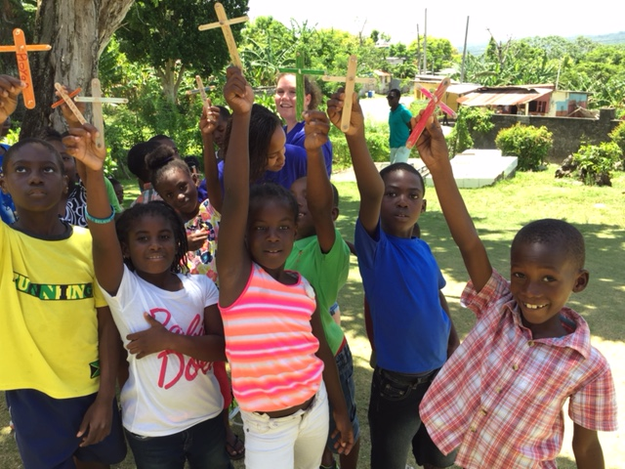


Sunday school in action

Slide 2
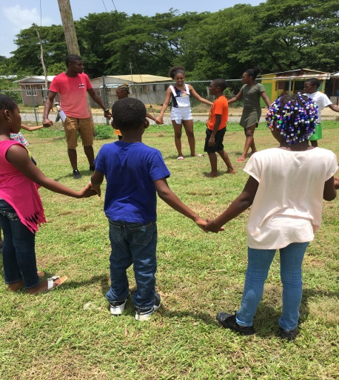
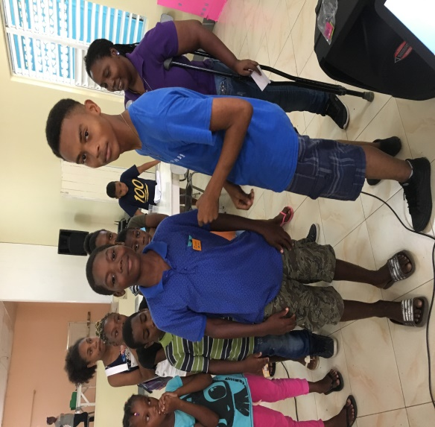
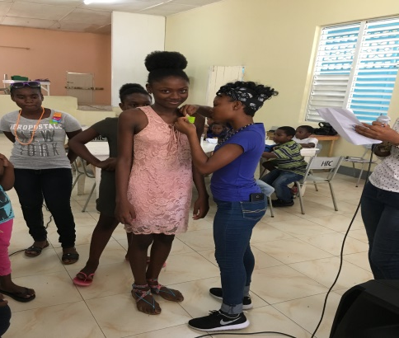
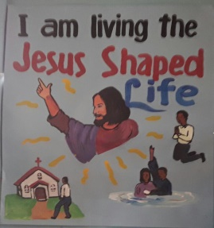
Sunday School In Action: Club Style

Slide 3
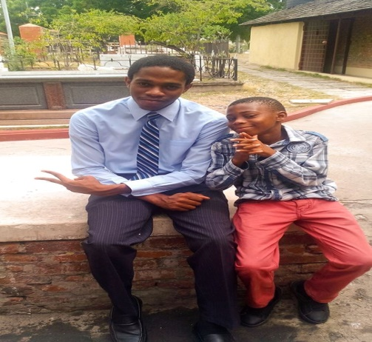
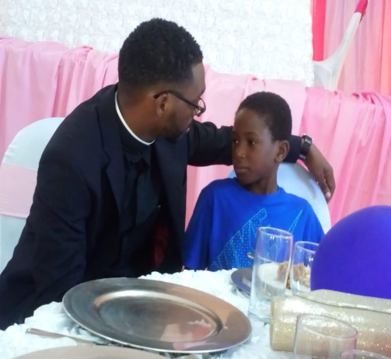
Club Style
Establish a Pal-Chum System
“After this the Lord appointed seventy-two others and sent them two by two ahead of him to every town and place where he was about to go.” Luke 10:1
Notes:
In a Pal Chum System – one is a pal and the other is a chum. A Pal or Chum is a friend, companion, intimate, familiar, confidante, who is (like my best friend) except that each is responsible for the other.
Taken another way “CHUM” is the bate that is used to catch fish – JESUS said “I will make you fisher for people (Matthew 4:19). Not all of us will be fishermen, some of us have to be the ‘bates’ or the support. So each person witnesses to the wider community by how they love and support each other.
They get points (using a token economy, chart or stars or other rewards) for maintaining this one basic rule of the club. Use the Luke 10:1 charge and tell them they are disciples/apostles who go out on the command of the Master (Jesus) to be an example to others and to return again with a report to the Master about their witness

Slide 4

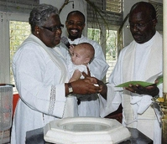
Baptismal Membership
2. All students are members of the church and kingdom of God through their baptism
“Then little children were being brought to him in order that he might bless them. The disciples spoke sternly to those who brought them; but Jesus said, “Let the little children come to me, and do not stop them; for it is to such as these that the kingdom of heaven belongs.” And he laid his hands on them and went on his way.” Matthew 19:13-15.
Notes:
It is the ideal to want to have children who are all baptized to be members of our Sunday school and majority may be. However, there will be and there are some who are not baptized. The focus of the Sunday School (Club-style) is to invite and involve everyone according to their competencies, abilities and likes. This will create a unique and dynamic group

Slide 5
We go to Sunday School to:
Learn more about God
Learn the Bible
Grow Spiritually
Work together for mutual benefit
Make friends

Slide 6
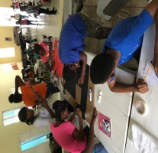
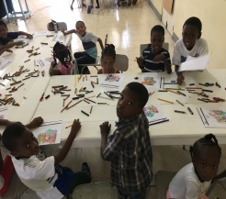
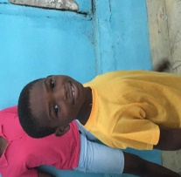
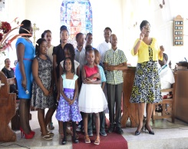
Sunday School Motto:
“Everyone deserves to hear about God:
TELL THEM”

Slide 7
Sunday School Prayer:
Lord, Jesus teach us how to live, to worship, pray and forgive We need your wisdom as we grow Your will and plans to strive to know Give us your grace to grow and learn And from your way to never turn May in our world your love increase ‘till every child knows your peace. Amen

Slide 8
A (Attract) I (Inquire) M (Measure)
LESSON PLANNING
Notes:
A lesson plan is a type of description of the course of instruction or “learning path” for a lesson. In other words, a lesson guides the class learning.

Slide 9
LESSON PLANNING
This three pronged lesson plan helps teachers and students grasp a concept, engage conversation as they delve deeper into a topic or story and then leave that engagement with a life skill

Slide 10
LESSON PLANNING
Step 1 ATTRACT
a.) Here, we can use a (PROP) an actual object, a picture or a piece of music; cartoon, videos, ourselves, or even a real life situation/story that can attract (grab) their attention.

Slide 11
LESSON PLANNING
Step 1 ATTRACT
b.) Talk about the significance of the picture and make a connection to the theme for the day

Slide 12
LESSON PLANNING
Step 1 ATTRACT
c.) Get learners to make a connection with the theme, the prop (picture etc.) and between past and present learning experiences

Slide 13
LESSON PLANNING
Step 2 INQUIRE
a.) Delve (go deeper) into the topic for the day. Read the bible story , use different versions of translations. You may even try a pass the read strategy or try to retell the bible story (if you can)

Slide 14
LESSON PLANNING
Step 2 INQUIRE
b.) Do an activity that will require them to think or get physically engaged – puzzles, mazes, games, colouring pages, even get the, to draw their interpretation of the lesson or main theme

Slide 15
LESSON PLANNING
Step 2 INQUIRE
c.) Bear in mind and tie in the big idea you want them to take home to their parent or friends when they leave Sunday School

Slide 16
LESSON PLANNING
Step 3 MEASURE
a.) How can they use any principle from the bible engagement in their daily lives? Here you can invite them to make a commitment to do something during the upcoming week and report at the next class. This report can form the first part of the next week’s lesson: (Attract)

Slide 17
LESSON PLANNING
Step 3 MEASURE
b.) What specific thing did you want students to learn. Have them repeat it here or a memory verse. What do we do in church (corporate worship) that they can strengthen as a result of what they have learnt?

Slide 18
LESSON PLANNING
Step 3 MEASURE
c.) What questions do they have?
Get students to verbalize what they have learned.
Be prepared to clarify or repeat or rephrase.
Notes:
At this step, if you had a reward system other than the students getting answers correctly or responding appropriately then it is a good time for reinforcement and pledge to engage the task (homework) throughout the coming week.

