Slide 1
SOCIAL MEDIA IN THE CHURCH
The Do’s, Don’ts and Don’t Ever

Slide 2
THE GREAT COMMISSION
¹⁹ Therefore go and make disciples of all nations, baptizing them in the name of the Father and of the Son and of the Holy Spirit, ²⁰ and teaching them to obey everything I have commanded you. And surely I am with you always, to the very end of the age.” (Matthew 28:19–20)

Slide 3
Media
The collective communication outlets or tools used to store and deliver
information. Generally associated with specialized mass media communication businesses such as print media and the press photography, advertising, cinema, broadcasting (radio and television), publishing and point of sale.
Scott M. Cutlip, Allen H. Center, Glen M. Broom

Slide 4
Social Media
Websites and applications that enable users to create and share content or to participate in social networking.
Hana S. Noor Al-Deen, John Allen Hendricks
Notes:
Our heavenly father is the master of innovation. He is the supplier of all our intelligence, and so inspires us to be innovative. Social media is just another tool in the media arsenal, a vehicle that transports or facilitates information sharing - But it only works if we choose to engage.

Slide 5
FACTS
The number of internet users worldwide in 2018 is 4.021 billion, up 7 percent year-on-year
The number of social media users worldwide in 2018 is 3.196 billion, up 13 percent year-on-year
The number of mobile phone users in 2018 is 5.135 billion, up 4 percent year-on-year
Global Digital Report 2018
Notes:
We are presented with an opportunity to make great impact through social media evangelism. As we venture into the social, digital era, the gospel can travel further and faster than ever before.

Slide 6
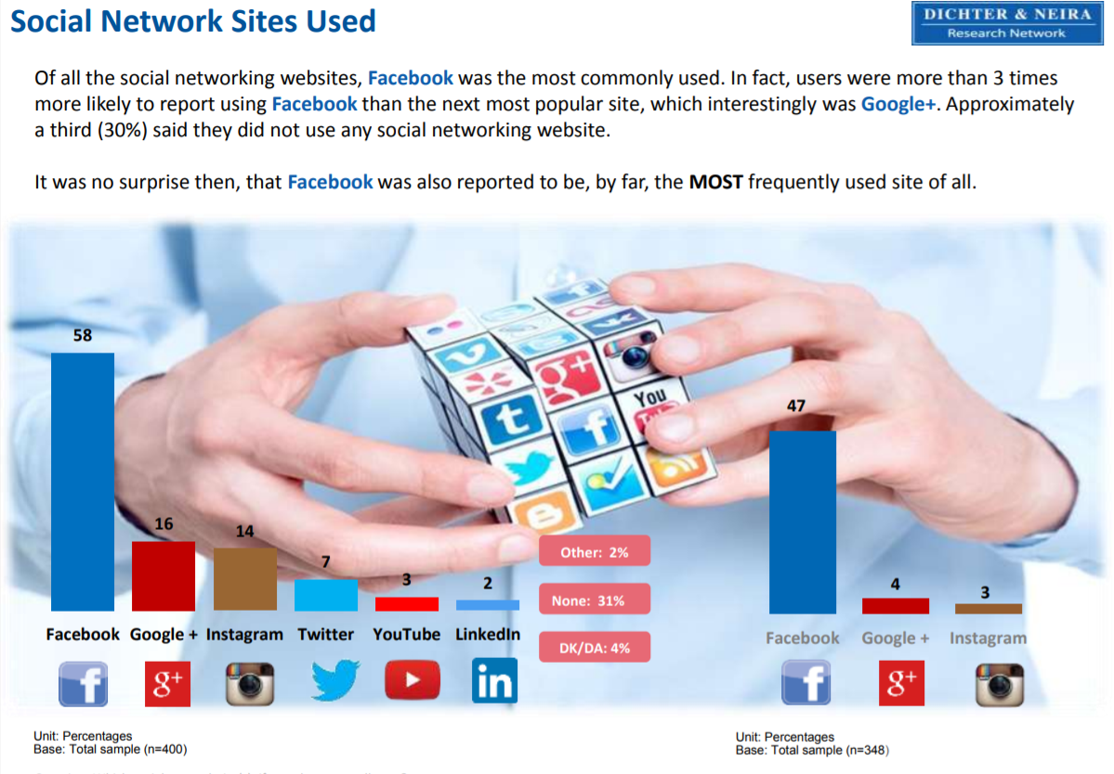
Dichter & Neira Insider: Jamaicans’ Social Media Usage
September 2015

Slide 7
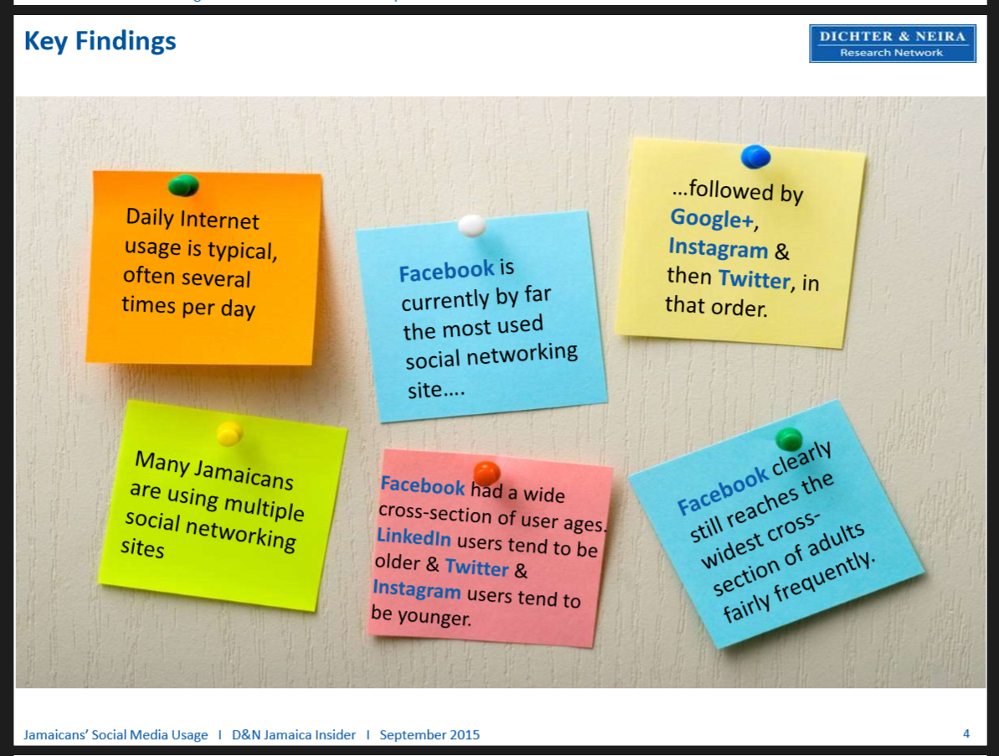
Dichter & Neira Insider: Jamaicans’ Social Media Usage
September 2015

Slide 8
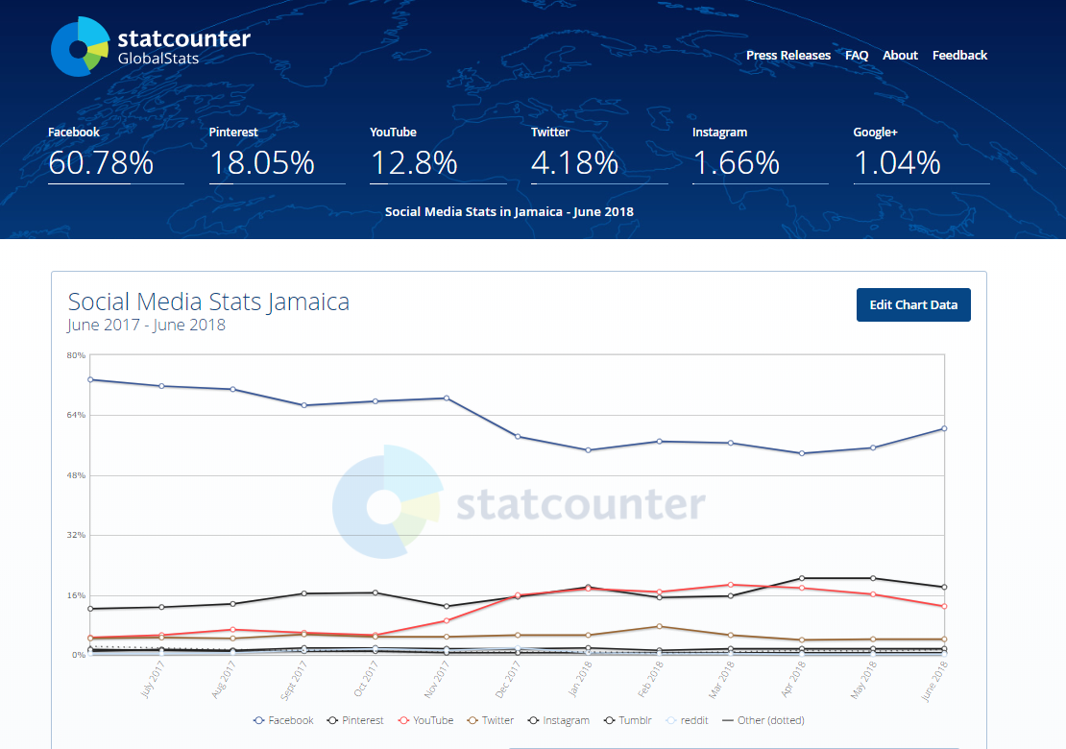
Notes:
FB 1.6mil - Pinterest: 487,350 - Youtube: 345,600 - Twitter: 124,200 - IG: 44,820 - Google+: 37,800

Slide 9
Why Social Media can work for you?
Social media currently represents the number 1 online activity globally and through creative storytelling, we can reach many people and lead them into a new life.
Social media has an extensive reach.
Social media is practically free except for the data charges.
Source: www.InternetLiveStats.com and International Telecommunication Union, World Telecommunication/ICT Development Report and database. 2016

Slide 10
Why Social Media is good for you?
The highest usage of social media is done on phones and individual mobile ownership in Jamaica is 3,267,344.
People love to participate in a story and co-create content. Social media makes this possible.
The sharing capability of social media makes it possible for a post to go viral and be amplified by other users in an instant.
Source: www.InternetLiveStats.com and International Telecommunication Union, World Telecommunication/ICT Development Report and database. 2016
Notes:
The proliferation of smartphones and the spread of connectivity by mobile network operators have enabled the internet to actually follow us wherever we go, at whatever time. This is good news for the Body of Christ in the context of our mandate to preach the Gospel to the whole world.

Slide 11

Types of Social Media and usage

Slide 12
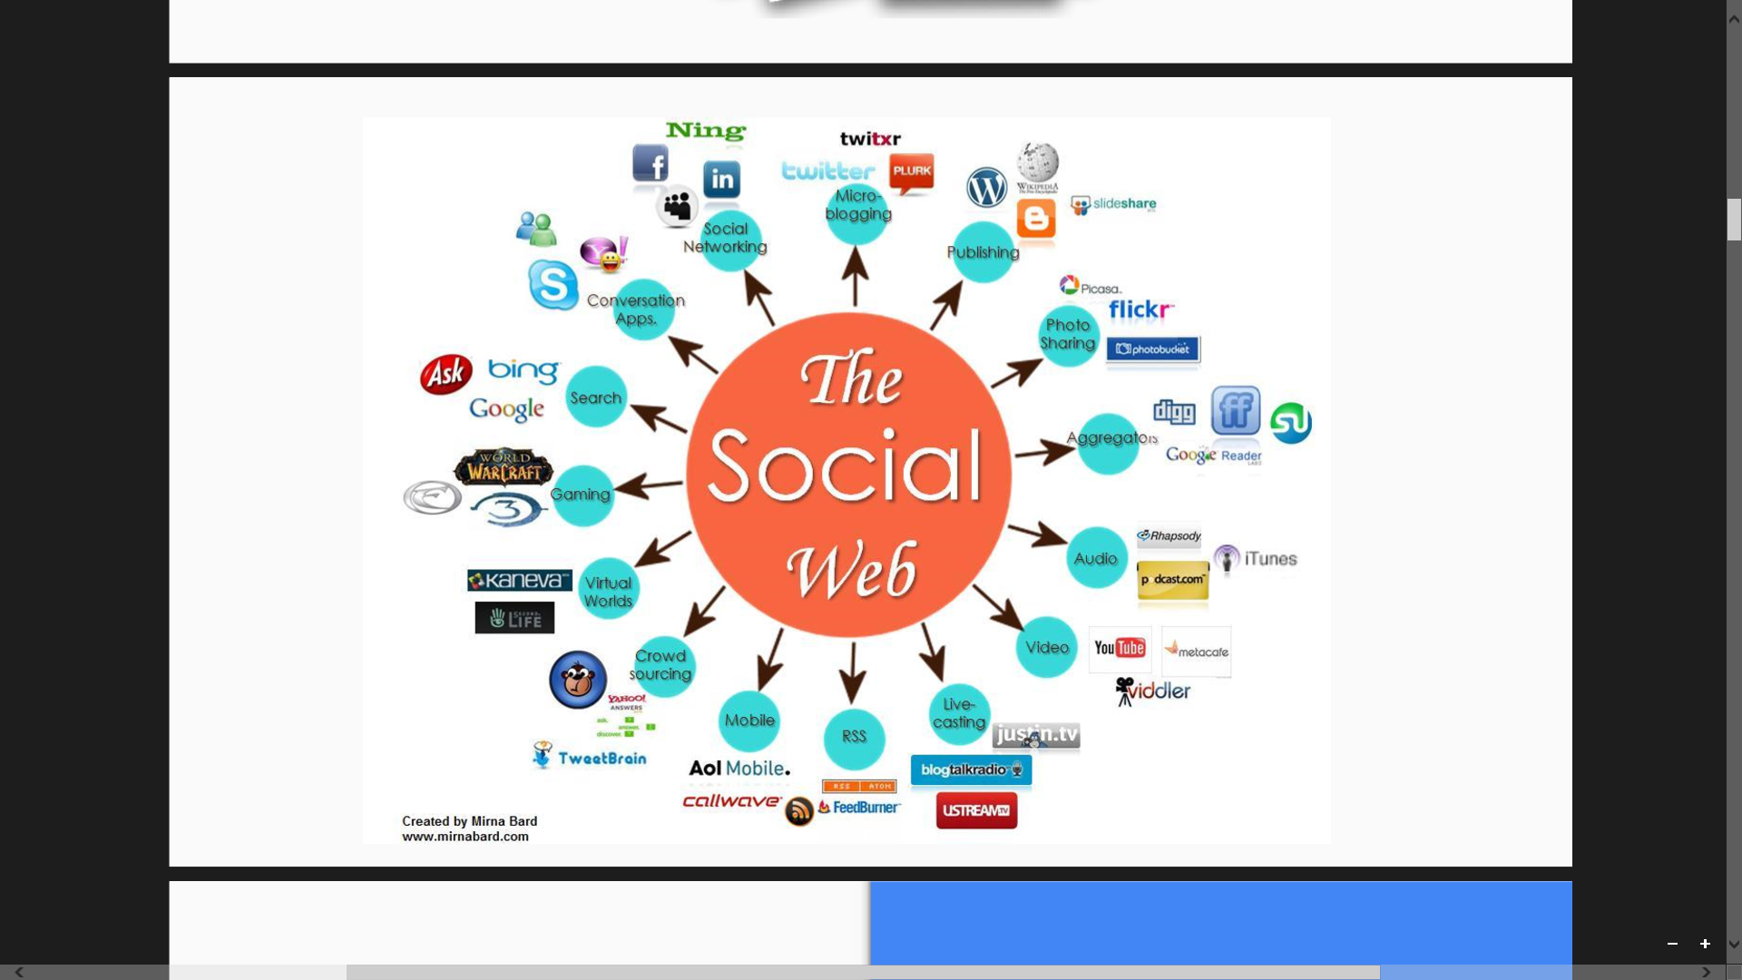
Types of Social Media and usage

Slide 13
FACTS
Your organization needs to be on social media
You don’t need to be on every SM platform
Know the most popular SM platforms
Monitor the trends
Go where your audience is
Identify the ones that work best for your organization
Notes:
We are presented with an opportunity to make great impact through social media evangelism. As we venture into the social, digital era, the gospel can travel further and faster than ever before.

Slide 14
30:78

Slide 15
STEPS TO A SOUND SOCIAL MEDIA PRESENCE
WHO
Identify your target audience
Have thorough knowledge about them
Understand their social media habits
WHAT
Know the goal of your campaign/program
WHERE
Be present where your target audience receives their information
Notes:
The most important thing to start with is a sound strategy. Simply being on a social platform is not enough. In-house survey of your congregation will help you to design the strategy that best serves you.

Slide 16
STEPS TO A SOUND SOCIAL MEDIA PRESENCE
WHEN
Know the days and times your target audience is online
WHY
What is the desired action/behaviour you hope to achieve?

Slide 17

STEPS TO A SOUND SOCIAL MEDIA PRESENCE
Select a few channels where you know your target audience spends much of their time.
Eg. Facebook, Twitter and Instagram
Photo credit:
Kantar Millward Brown

Slide 18
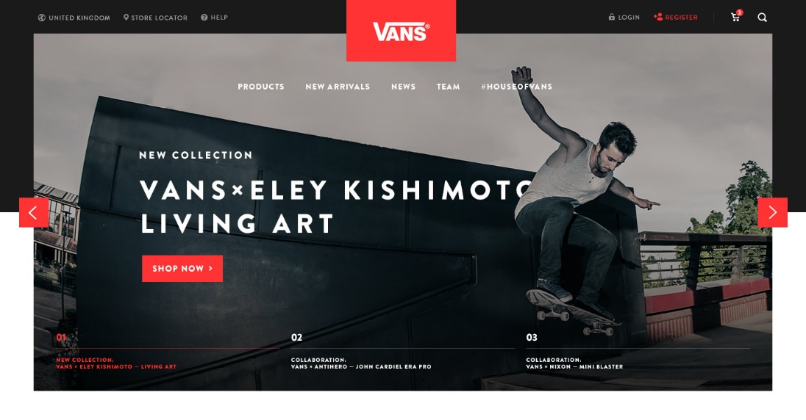
STEPS TO A SOUND SOCIAL MEDIA PRESENCE
Customise the platforms with creative artwork that represents your brand. This includes logos, pictures, concise descriptions of your church and contact details.

Slide 19
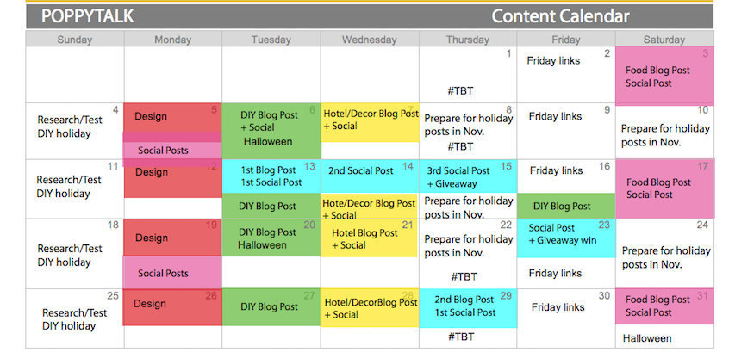
STEPS TO A SOUND SOCIAL MEDIA PRESENCE
Create a content strategy that includes:
Topics
Seasonal themes
Formats of post (video, text or image).

Slide 20

STEPS TO A SOUND SOCIAL MEDIA PRESENCE
Appoint a social media manager:
Social media management roles should be based on a number of criteria that includes, individual’s ability to connect with people, listening skills, creative mind-set, strategic thinking.
Photo credit:
Joel Lee
Notes:
Social media tools are the nets that can capture the souls that we are mandated to reach out to. There is need to be strategic and creative in engaging the target audience.

Slide 21
FACEBOOK
How do we use Facebook to drive engagement for church events or websites – How important is it to ‘promote’ ads?
Step 1: Post engaging content. Create a new post or go to any post you've recently created on your Page/Timeline. ...
Step 2: Click Boost Post. ...
Step 3: Choose your audience. ...
Step 4: Choose your budget. ...
Step 5: Set up your ad payment. ...
Step 6: Boost your post. ...
Step 7: Measure your results.
Facebook for Business

Slide 22
TWITTER
How do we use Twitter to drive engagement for church events or websites – How important is it to ‘promote’ ads?
Choose a Tweet to promote. Click on the activity icon for any Tweet in your timeline, on your mobile phone or from your computer. ...
Click on “Promote this Tweet"
Select the location you'd like to target. ...
Select your budget. ...
Confirm your spend.
Measure your results.
Facebook for Business

Slide 23

OTHER PLATFORMS

Slide 25
FROM SERMON TO SOCIAL MEDIA
What is your goal?
What behaviour/action would you like to achieve?
Live streaming
Simultaneously record and broadcast in real time to the viewer.
Sermon summary
A concise version to the weekly sermon done in text and posted to SM platforms/website

Slide 26
FROM SERMON TO SOCIAL MEDIA
Get the conversation going or keep the conversation going from Sunday’s message.
Ask questions to tease the idea of the upcoming sermon you’re preparing
Start a dialogue to involve your congregation in your sermon preparation.

Slide 27

Notes:
In two or four group. Each group is assigned a scenario. First answer the five ‘W’s as discussed, then tackle the question

Slide 28
Scenario 1: Church A located in rural community of Tomato Sauce.
Population: 100,000
Population SM presence: FB / IG / Twitter
Church A’s SM presence: Website and FB.
Demographic: 55% youth and young adults (Age range 20-45)
Target demographic: 55% youth and young adults (Age range 20-45)
Church A’s Youth Fellowship is hosting a valentine dinner. Draft a strategy using social media for promoting the event.
Scenario 2: Church Blessed B located in suburban community of Prune Juice. Population: 300,000
Population SM presence: FB / IG / Twitter / Blog sites
Demographic: 35% young adults (Age range 20-39), 15% Adults (40-55), 25% seniors, 15% teenagers, 10% children under 13
Church Blessed B’s SM presence: Website and FB.
Church Blessed B has a high rate of young adult members entering University, located in the heart of the city, resulting in low church attendance. Draft a strategy using social media, showing how to engage/reach this audience type.

Slide 29
Scenario 3: Church M is located in the town of Orange Marmalade.
Population: 375,000
Population SM presence: FB / IG / Twitter /blog page
Demographic: 35% young adults (Age range 20-39), 15% Adults (40-55), 25% seniors, 15% teenagers, 10% children under 13
Church M’s SM presence: Website and FB.
Church M’s multimedia ministry has launched their live streaming of Sunday sermons and a new Instagram page. Draft a strategy using social media for promoting this new endeavour.
Scenario 4: Church Glorious is located in suburban community of Apple Cinnamon. Population: 250,000
Population SM presence: FB / IG / Twitter / Blog sites
Demographic: 35% young adults (Age range 20-39), 15% Adults (40-55), 25% seniors, 15% teenagers, 10% children under 13
Church Glorious does not have a social media presence.
Based on survey of member social media usage, draft a strategy using social media, showing how to introduce new SM platforms and how you could engage members.

Slide 30


Slide 31


Slide 32
23.60

Slide 33
26:43

Slide 34
CLEO WALKER
cvs.walker.cleo@gmail.com
(876) 857 4738

