Slide 1

DIOCESE OF JAMAICA & THE CAYMAN ISLANDS
JAMAICA CHURCH MISSIONARY SOCIETY
REPORT FOR THE YEAR 2017
Notes:
The JCMS is its 157th year as the missionary agency of the Church in Jamaica and the Cayman Islands.

Slide 2
OBJECTIVES
Establishment, maintenance and extension of missions throughout the Diocese.

Slide 3
SUMMARY 2017
Emphasis: The expansion of our Mission field and considerable resources were channelled to this end.
Challenges: Demographic, Social & Economic changes
Response: Devising new strategies, to match the changing landscape, while keeping the focus on the mission field to which Christ has called us.

Slide 4
Response to the Challenges –
2018
With the timely launch of the period of Intentional Discipleship (ID) in November 2017, the JCMS will be focusing on the training of congregations for the mission field.
It is our objective for persons to take on a new ID, that of persons living JESUS-SHAPED lives.

Slide 5
Operational & Financial Plan
2017 - 2018
Focus:
EVANGELISM & TRAINING
- partnering with the Church Army and the Education & Youth Department to fulfilthe second Mark of Mission:
“To teach baptize and nurture new believers”.

Slide 6
WELCOME
Sister Claudette Marshall
General Secretary
Director of Mission & Ministry
Mrs. Jacqueline Mighty
  who in her capacity as Diocesan Secretary fulfils the role as Treasurer of the Society.
Notes:
Before we go any further, join me in welcoming…
Sister Claudette succeeds Mrs. Carmen Bromley: The General Committee has drafted a resolution for presentation to the Synod in recognition of Mrs Bromley’s service.

Slide 7
DIOCESAN MISSIONS
Three (3) Diocesan Missions
SPOT VALLEY
DISCOVERY BAY
LONGVILLE PARK
Notes:
Spot Valley, Montego Bay ; Discovery Bay, St. Ann; Longville Park, Clarendon

Slide 8
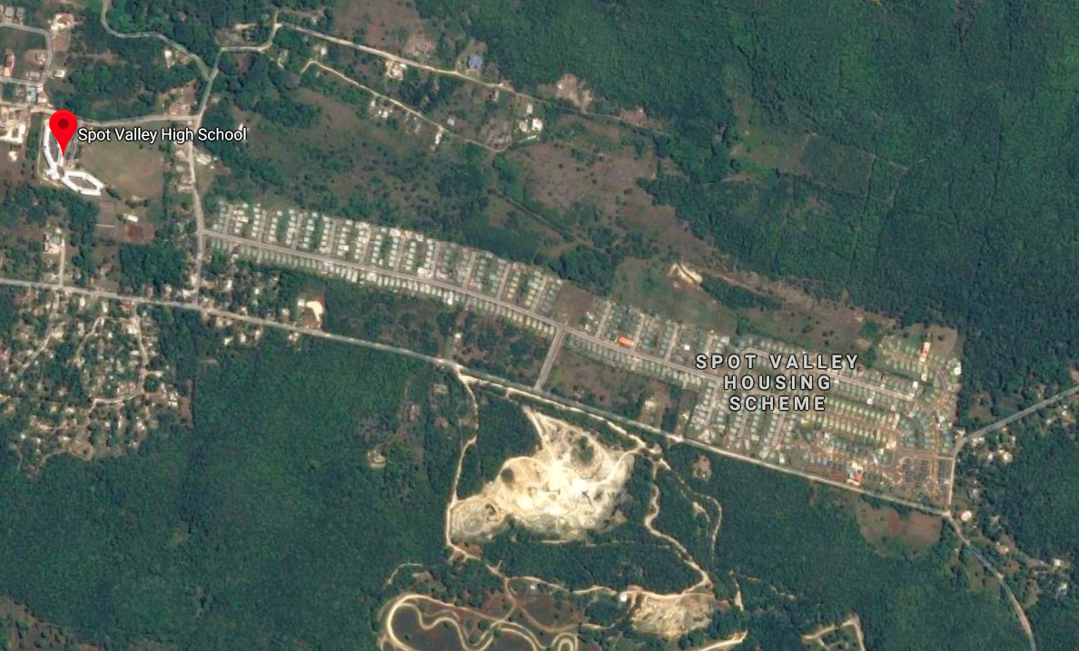
Spot Valley Mission

Slide 9
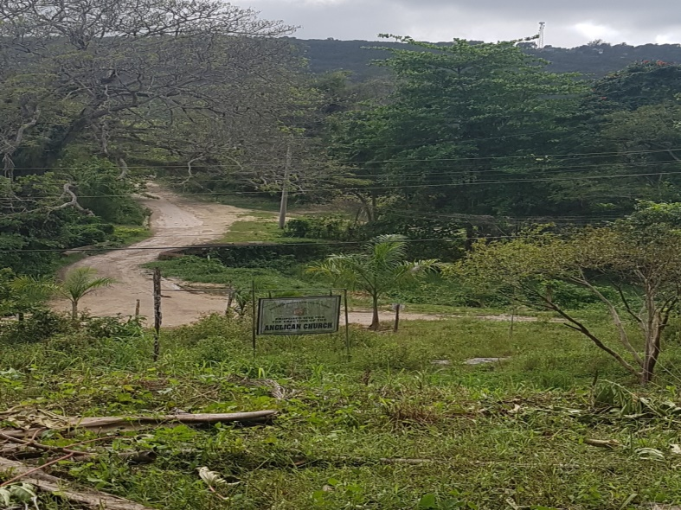
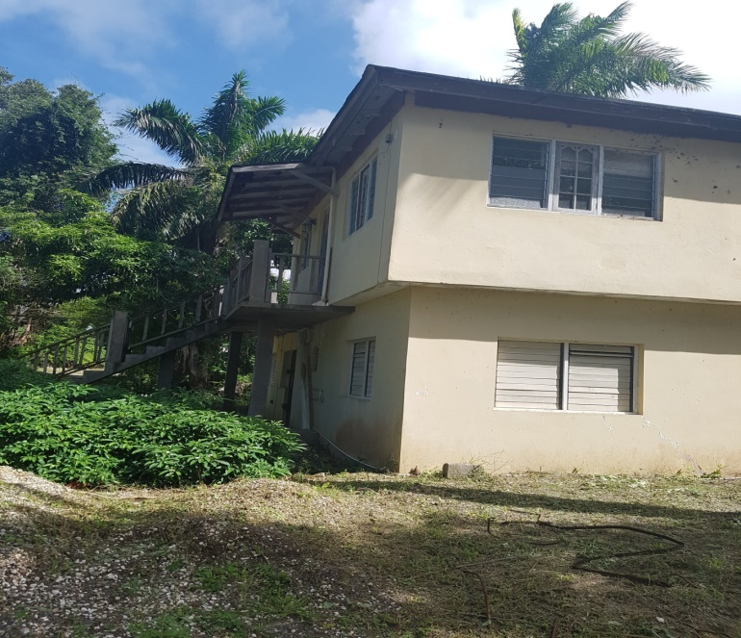
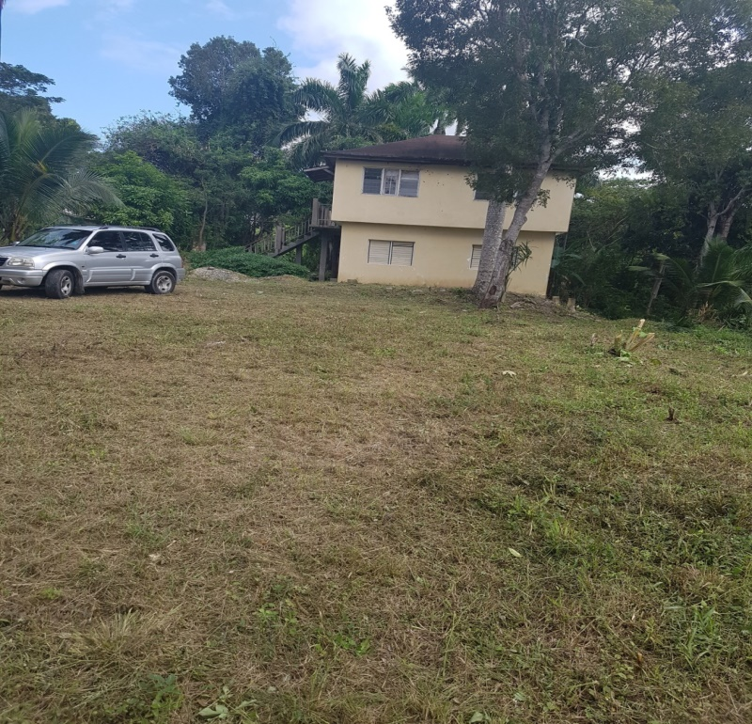
Spot Valley Mission

Slide 10
PROFILE
Settled Community
Population – approx. 27,000
Primary and Secondary Educational Institutions
Opportunities for training & employment of youth

Slide 11
Current Status
Personnel Challenges
Strategic pause on missionary work in Spot Valley
Deanery of St. James & the Archdeacon to determine the way forward.
Archdeacon of Montego Bay has assumed responsibility for oversight of the property.
In the interim JCMS offers minimal grant funding

Slide 12
Profile – Discovery Bay
Heavy local & tourist traffic
Number of returning residents
Locals relocating to the area
Small & large business concerns
Hotels and educational institutions

Slide 13
Discovery Bay
Meet at 4:00 p.m. on Sundays at the Roman Catholic Church
Weekly Bible Studies in homes
Core group of eight (8) persons augmented with overseas visitors & local congregations for special events
Not attached to a Cure but gets strong support from the Rural Dean, the Very Rev. Richard Tucker, Rev. Garfield Campbell of St. Mark’s and the Ocho Rios Chapter of the BSA.

Slide 14
ACTIVITIES
Part of the Runaway Bay/Discovery Bay Ministers’ Fraternal
Lead monthly devotions at the Discovery Bay All-Age School
Engaging returning residents to the area
Notes:
The JCMS will be working with the Church Army to give additional support to this Mission in 2018.

Slide 15
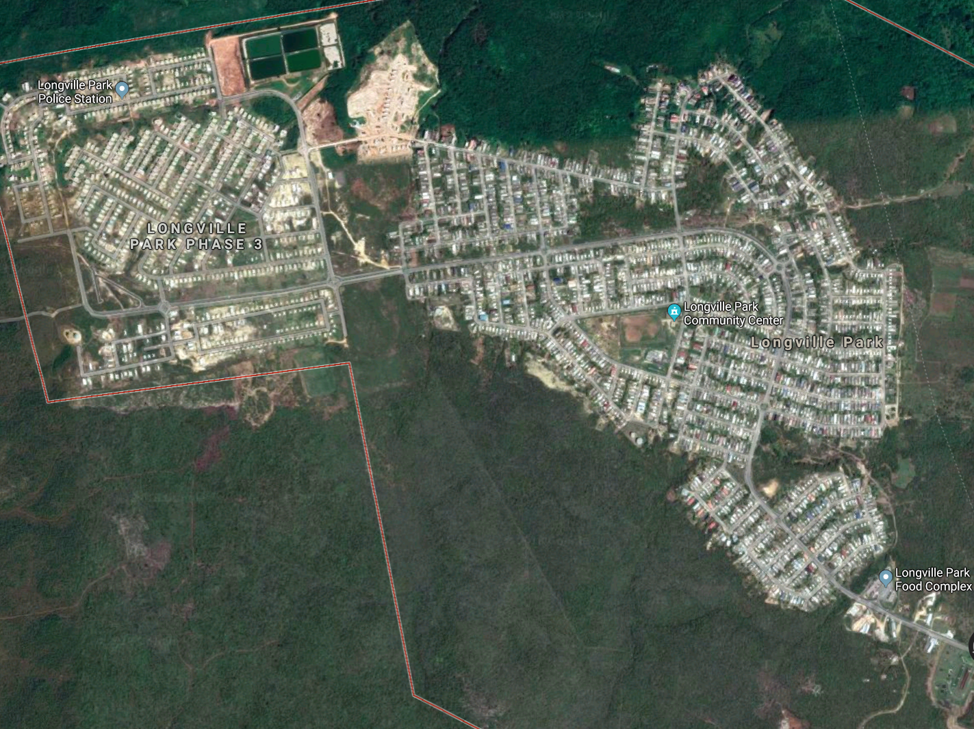
Longville Park
Notes:
Let’s take a look at this aerial view of Longville Park

Slide 16
PROFILE
What is the Potential Here?
Dormitory Community
5,000 Housing Solutions – (second only to Greater Portmore in terms of large scale developments in Jamaica)
Residents relocating from other communities
Increasing Population
Young families with children
People travel out for social activities
Notes:
We have identified Anglicans who live in the community. What have we done so far and plan to do?

Slide 17
Opportunities for Missionary Outreach
Homework Centre
Parenting Programme
Home Bible Studies
Community Recreational Activities – e g Movie NIght
Notes:
Lenten programme assisted by Sis. Norma.
Computer, furniture and material acquired for Homework Centre.
Need additional help.

Slide 18
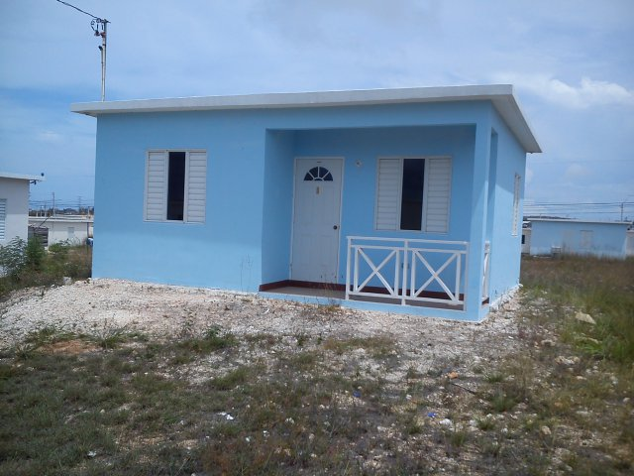
Longville Park Mission
BEFORE
Notes:
Purchase of a Mission House. Diocese took possession in December 2014. Steering Committee appointed chaired by Fitz Carty. Sister Alvarine Roberts resides at the Mission House and has the responsibility for leading the missionary activities.

Slide 19
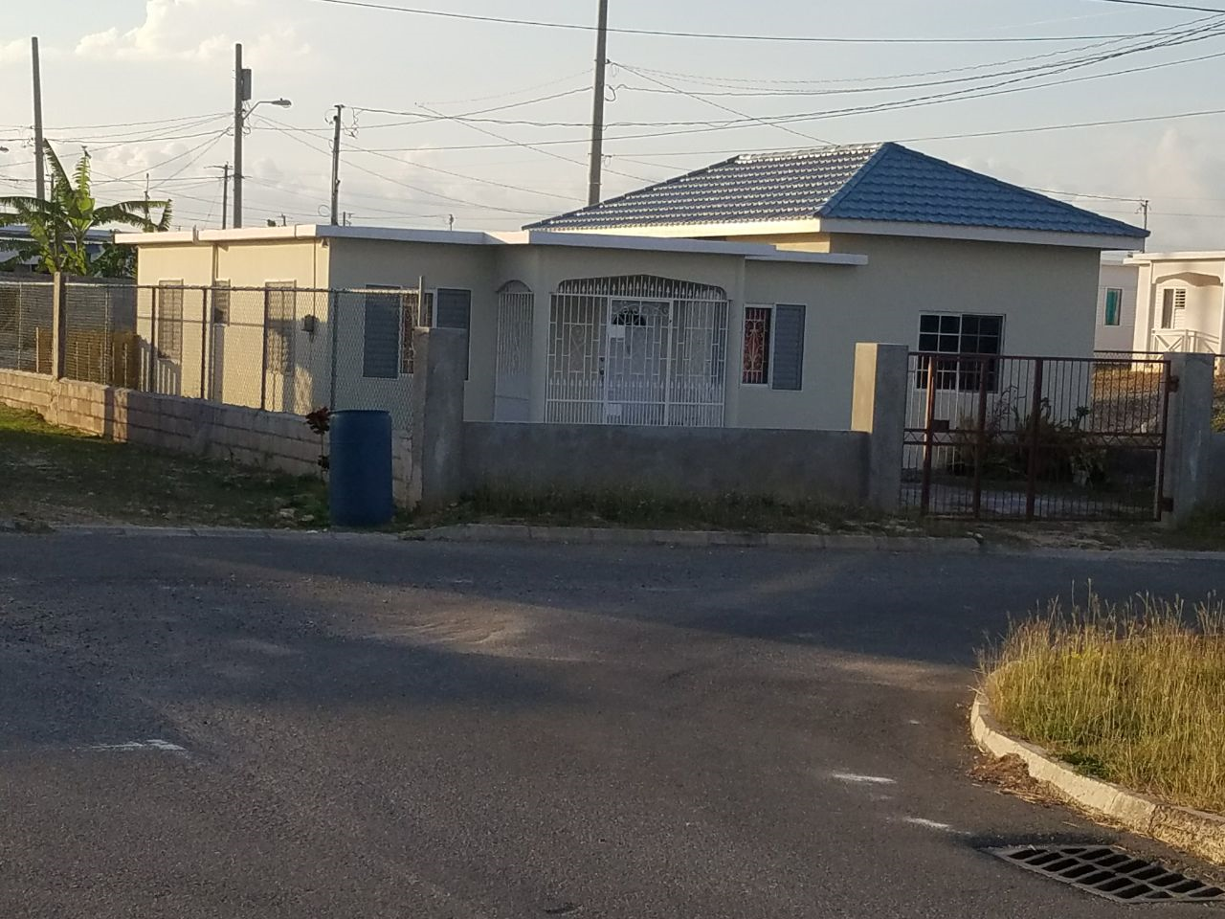
Longville Park Mission
AFTER
Notes:
After extension to accommodate activity centre. Capital Disbursement in 2017 of approx $1.3 million.

Slide 20
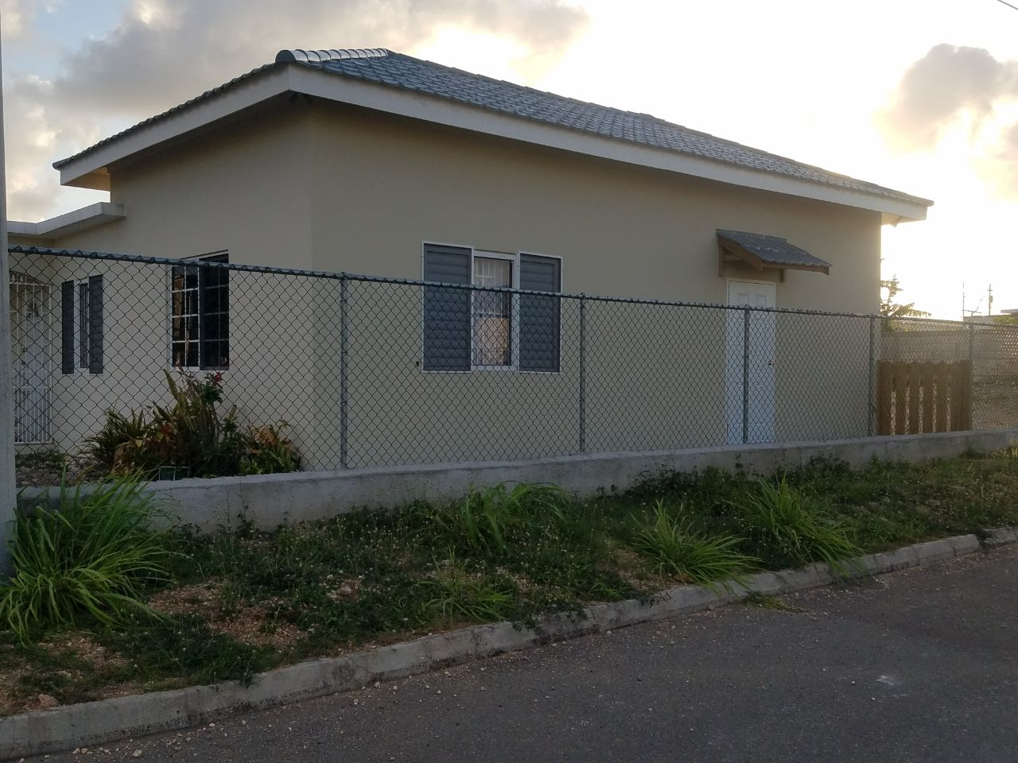
Notes:
Sunday School and Meetings currently takes place in the completed extension.

Slide 21
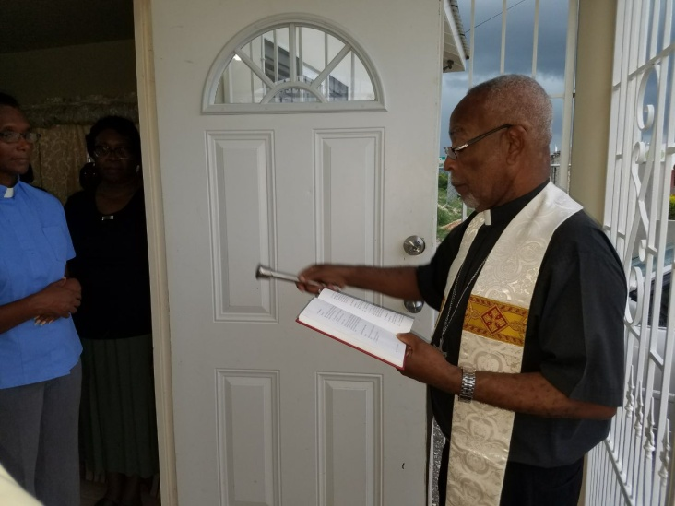
Blessing of the Extension/ Mission House

Slide 22
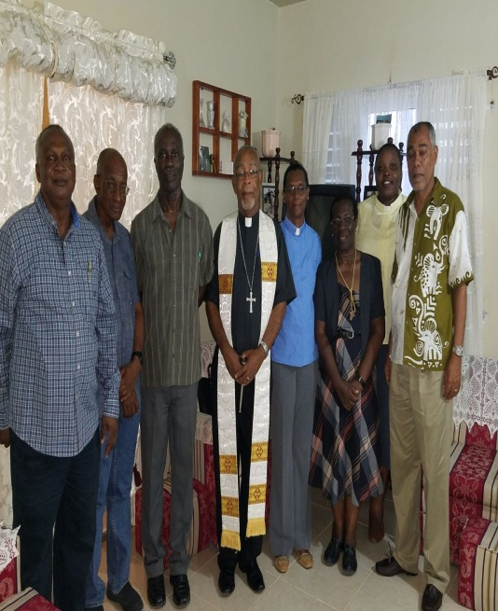
Notes:
Archdeacon Thomas with some members of the Steering Committee.

Slide 23
Remedial Work
After completion of the extension, we embarked on Phase 2 - extension to the back of the premises and landscaping.
Thanks to the BSA for their contribution towards this project

Slide 24
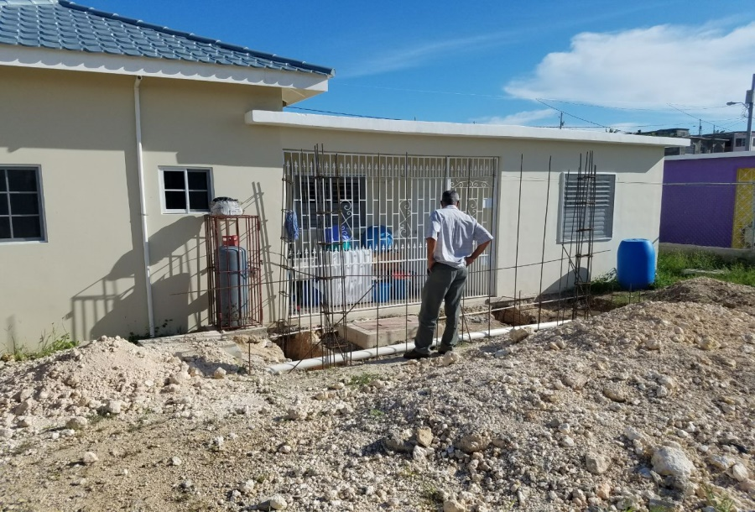
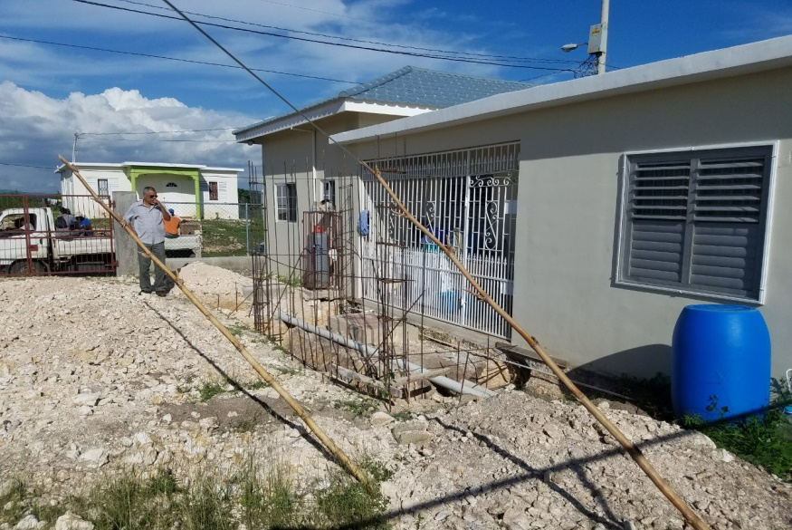
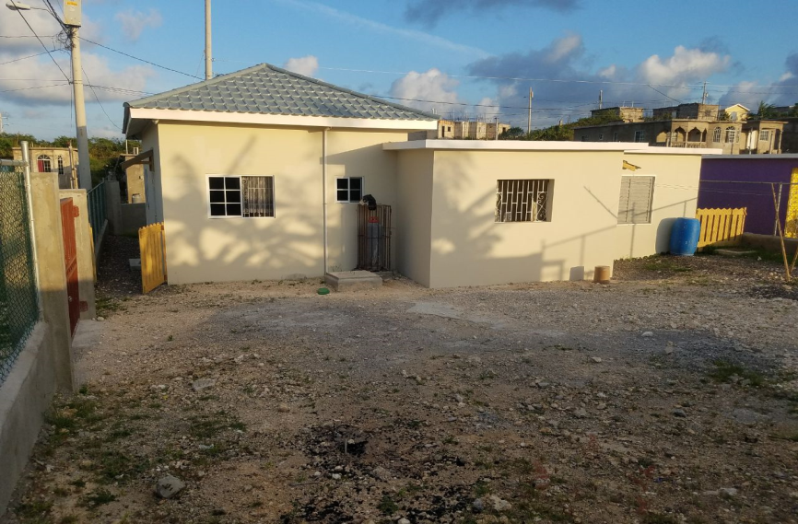
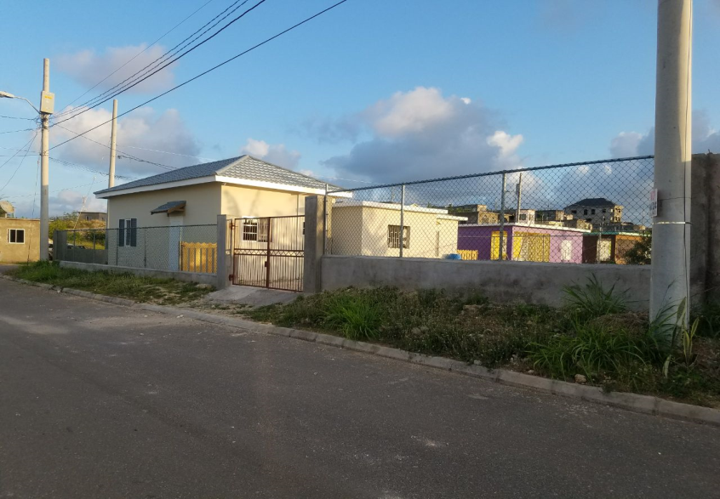
Longville Park
Remedial Work

Slide 25
ACTIVITIES - 2017
SUNDAY SCHOOL
MEETINGS
OUTDOOR SERVICES
VACATION BIBLE SCHOOL
CAROL SERVICE
Notes:
The JCMS covers the costs of operations, including transportation for all the activities.

Slide 26
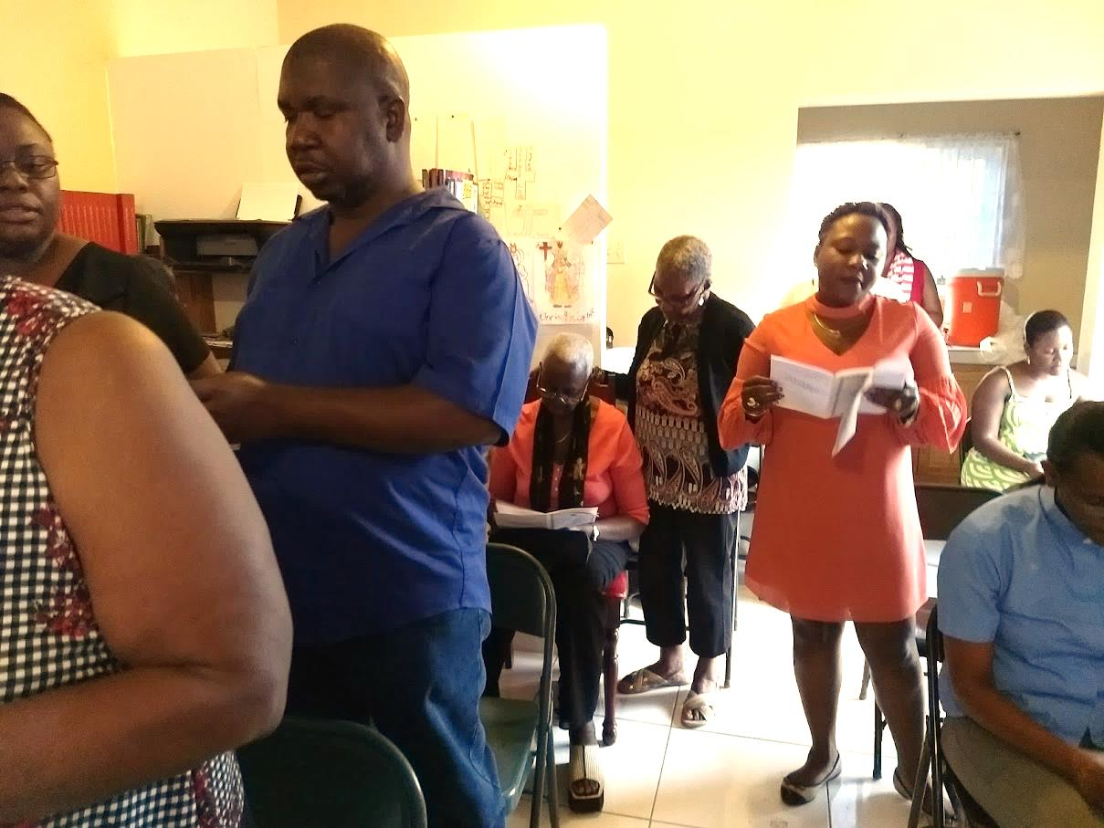
Carol Service 2017

Slide 27
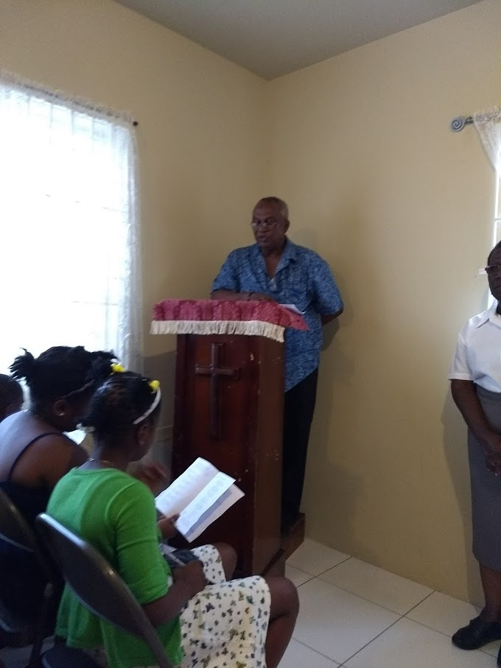
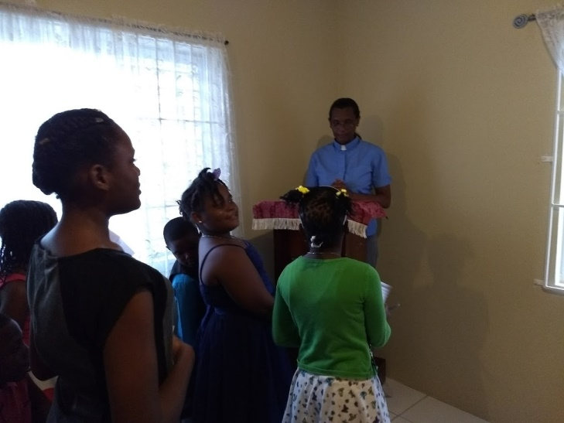
Reading the lesson
Notes:
Parents and members of St. Gabriel’s participated in the service. Rev. Lorraine Geddes-McDonald gave the message.

Slide 28
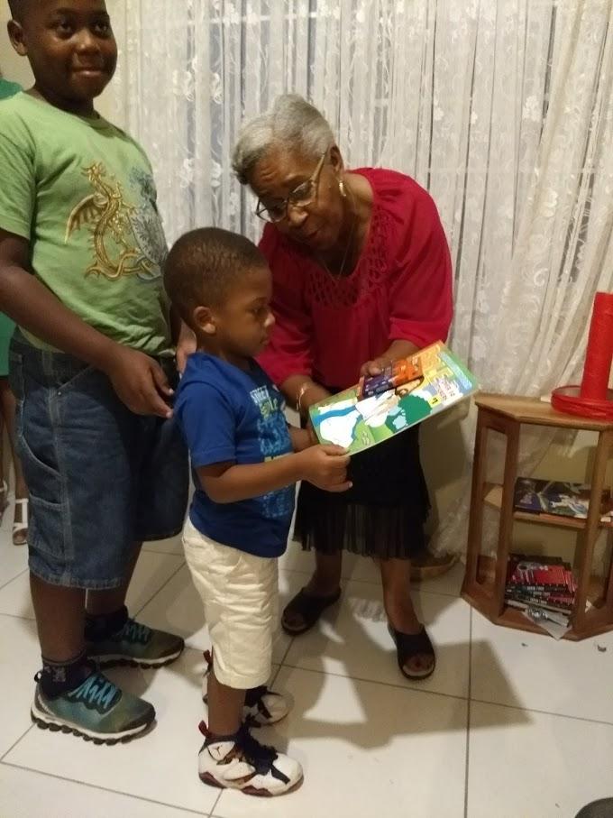
Presentation of Certificates and Prizes

Slide 29
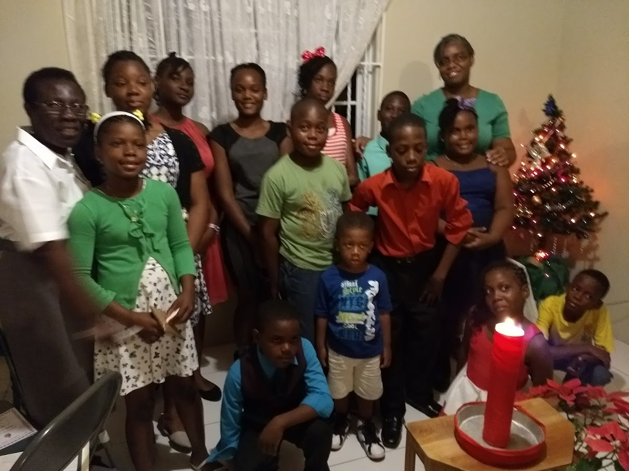
The Choir

Slide 30
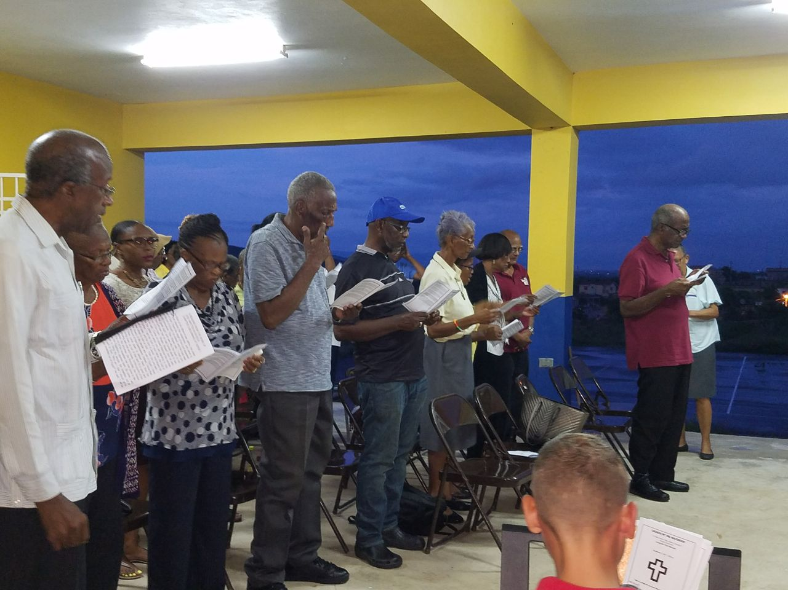
Outdoor Service at the
Community Centre
Notes:
Missionary Service led by Fr. Michael Allen and Members of the Church of the Ascension.
Support has also been received from Church of the Holy Spirit, The Cathedral, Spanish Town & Christ Church, Vineyard.

Slide 31
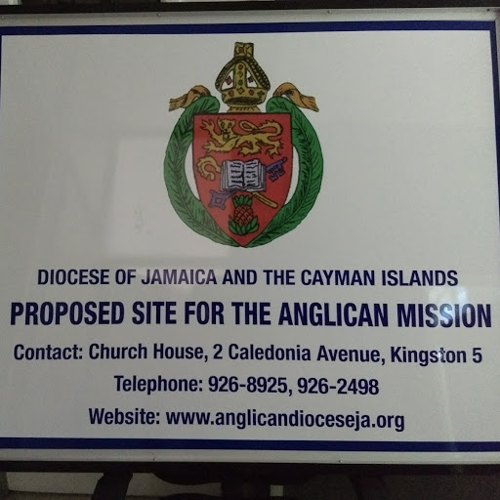
Lot 859
Longville Park
Phase 111
Notes:
Lot 859 Longville Park - Agreement signed and executed March 2017. Site for new Church Building. The community of Longville will be engaged in the establishment and ownership of the new building.

Slide 32
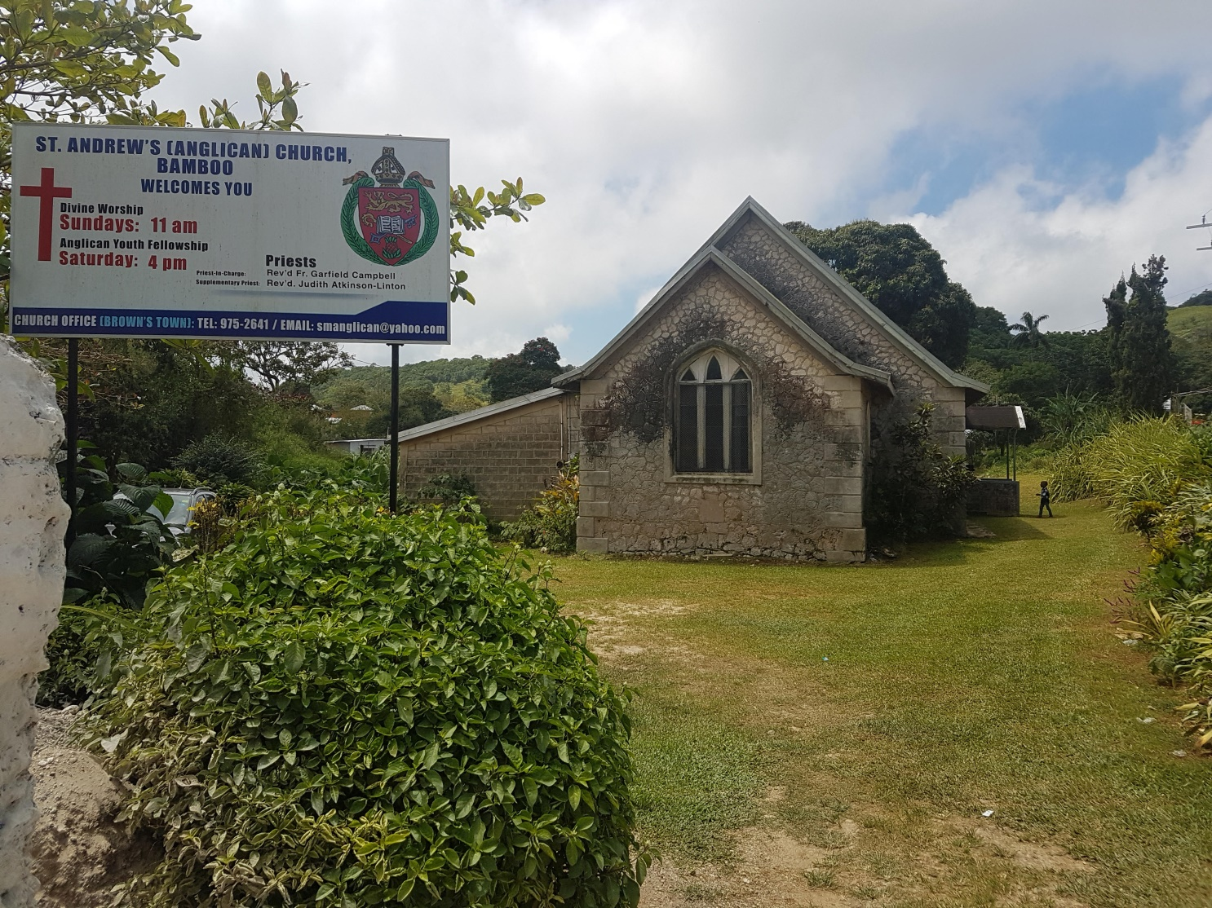
St. Andrew’s, Bamboo
Mission Settled Congregation
2022
Notes:
The JCMS notes that activities are also happening in other Missions across the Diocese, is encouraged by the creativity. Focus of St. Mark’s Cure –2017: Mission to be re-classified as settled congregation by 2022 – a whole Cure effort strongly supported by the local BSA.

Slide 33
Activities during 2017
Development of Strategic Plan in consultation with the Church Army
Whole Cure effort. Major Cure activities at St. Andrew’s
Members travel from St. Mark’s, Browns Town for Sunday Services
Supported by the Local Chapter of the BSA

Slide 34
St. Barnabas, Enfield, St. Mary
Church badly damaged by Hurricane Gilbert in 1988.
Flooding and safety concerns led to its abandonment
Services convened at the vacated Enfield Primary School in 2013
JCMS responded to an appeal to help in the renovation of school building for worship services

Slide 35
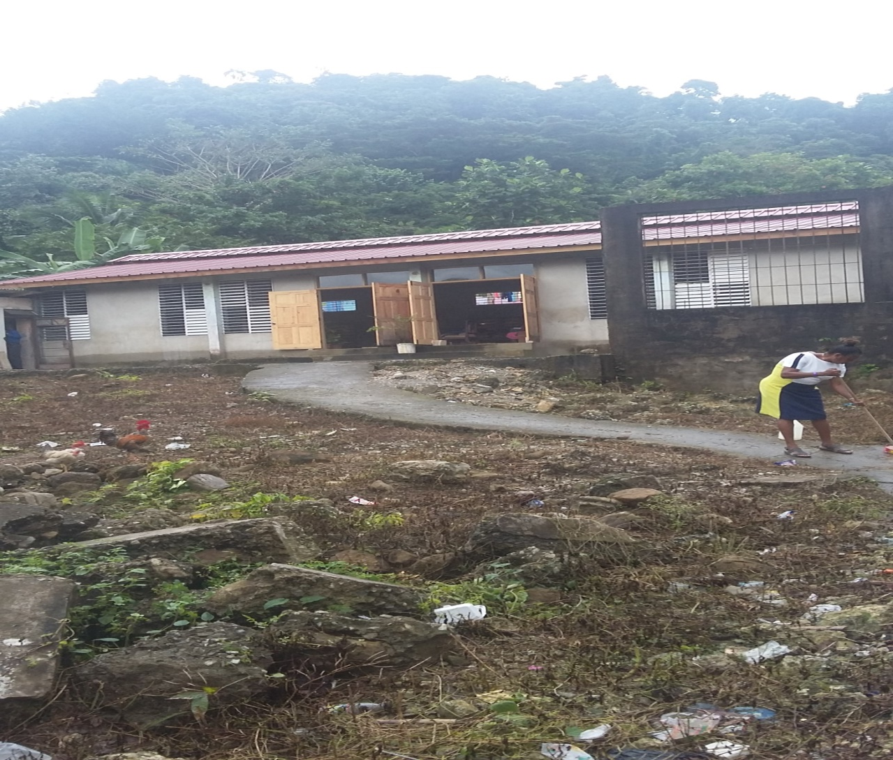
ENFIELD MISSION, ST. MARY
A NEW START
Notes:
Currently has an active membership of thirty-two (32) persons in addition to thirty (30) Sunday School Children.

Slide 36
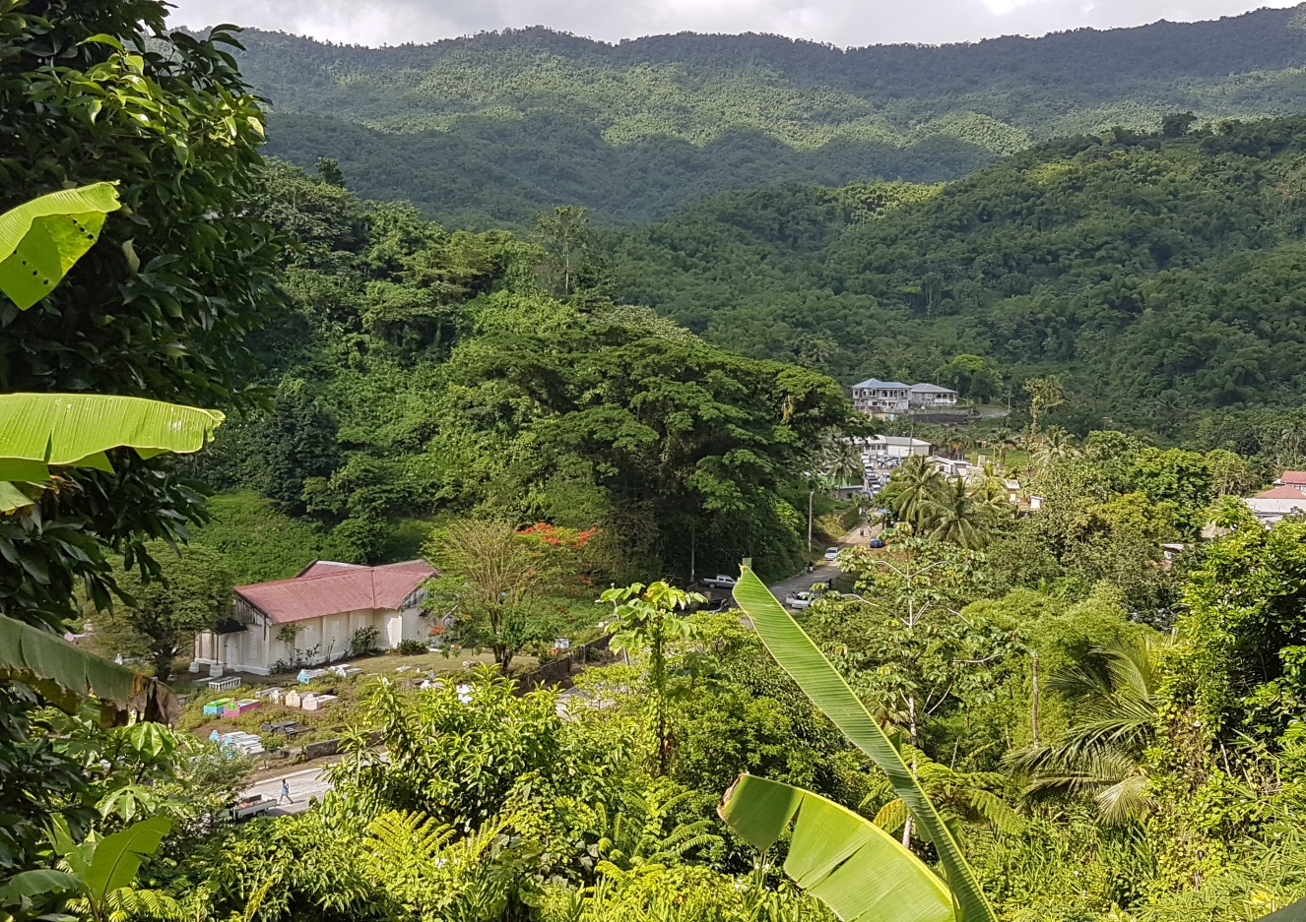
JCMS Summer-Assist
Rio Grande Valley
Notes:
UTCWI Summer Placement Programme supported by JCMS

Slide 37
Rio Grande Valley
Three Missions were involved in the programme:
All Saints, Fellowship
St. Paul’s Moore Town
St. Luke’s Comfort Castle
The Seminarian lived and worked in the community for two (2) months, participating in scheduled Church and community activities.

Slide 38
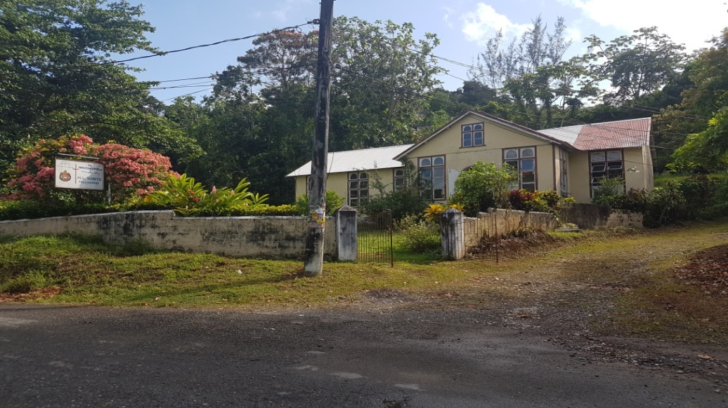
All Saints, Fellowship

Slide 39
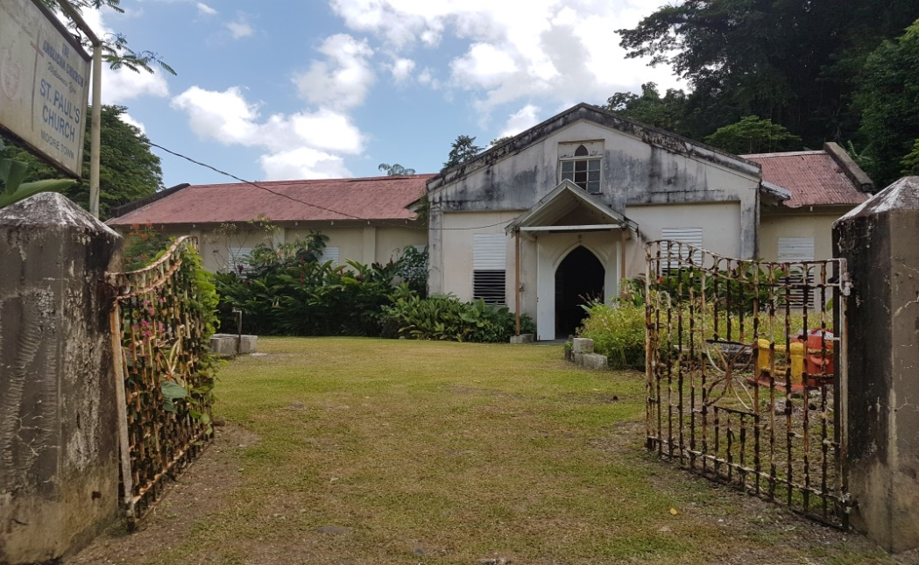
St. Paul’s , Moore Town

Slide 40
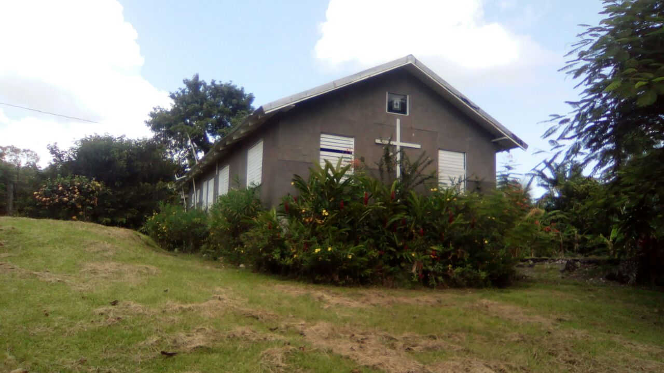
St. Luke’s Comfort Castle

Slide 41
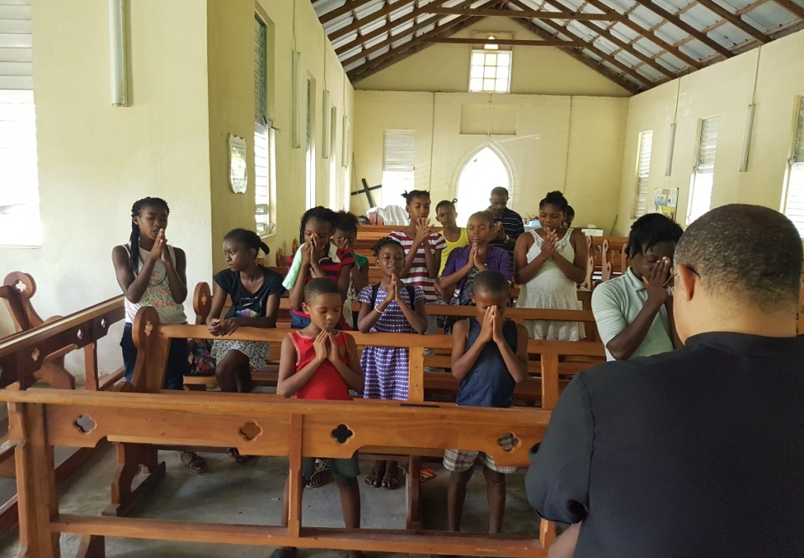
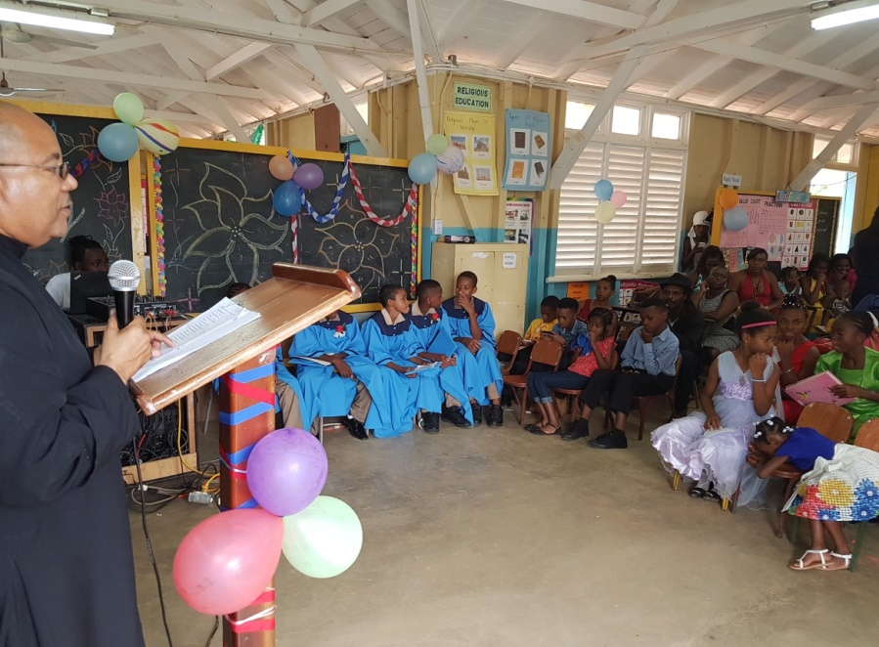
Vacation Bible School & School Leaving Exercise
Notes:
Children praying at St. Paul’s at the end of VBS. Graduation exercise at Cooper’s Hill Primary. See appendix 1 in printed reports.

Slide 42
Disbursement of Funds
2017
PROJECTS/ INSTITUTIONS | $
Longville Park Dev. | 1,333,716
Longville Park Operations | 277,591
St. Monica’s Childrens’ Home | 90,000
The Wortley Home | 90,000
Clifton Boys’ Home | 150,000
Discovery Bay Mission | 140,000

Slide 43
Disbursement of Funds 2017
(contd.)
PROJECTS/ INSTITUTIONS | $
St. David’s Yallahs – VBS | 50,000
St. Andrew Deanery – Mission 2017 | 50,000
Bible Society of the West Indies | 60,000
U.T.C.W.I. Summer Placement | 90,000
Bernard Lumsden Skills Training Institute | 58,552
Publication of Brochures/ Phamphlets | 100,000

Slide 44
Disbursement of Funds 2017
(contd.)
PROJECTS / INSTITUTIONS | $
Hymn & Prayer Books – Emmanuel Chapel, Nuttall Hospital | 12,250
Hillcrest Retreat Center – Vocation Weekend | 76,000
TOTAL | 2,578,109

Slide 45
Deanery Contributors
St. Andrew $928,413
St. James $884,102
St. Elizabeth $608,160
Manchester $451,925
Westmoreland $390,996
St. Ann $383,470

Slide 46
Top Church Contributors
Churches
Amount
St. James Parish Church
St. Ann’s Parish Church
St. Andrew’s Parish Church
Church of the Transfiguration
$203,550
$146,937
$143,750
$130,221

Slide 47
The Top Church Contributor 2017
Church of the Holy Trinity West Gate
Montego Bay
Notes:
Notwithstanding these top contributors, we would like to make special mention of the members of St. John’s, Portland Cottage, who for the first time in over 12 years gave a contribution of $10,000 towards their Deanery’s Quota.

Slide 48
Summary
Income Statement
J$M | Actual 2017 | Budget 2017 | Actual 2016
Total Revenue | 5.53 | 6.89 | 5.47
Expenses:
Personnel Exps. | 0.97 | 0.85 | 0.81
Ministry Exps. | 0.28 | 0.90 | 0.55
Admin. Exps. | 1.39 | 1.24 | 1.19
Grants | 2.80 | 3.49 | 2.98
Total Exps. | 5.44 | 6.48 | 5.53
Net Income (Loss) | 0.09 | 0.41 | (0.06)
Notes:
Tabling the Audited Statements for years 2015 & 2016.

Slide 49
Deanery Quotas - 2018
Regions | Deaneries | Budget 2017 ($) | Actual 2017 ($) | Budget 2018 ($)
Kingston | Kingston | 600,000 | 271,746 | 500,000
 | St. Thomas | 200,000 | 52,480 | 200,000
 | St. Catherine | 300,000 | 118,050 | 300,000
 | Portmore | 170,000 | 105,000 | 150,000
 | St. Andrew | 1,000,000 | 928,413 | 1,000,000
 | St. Mary | 350,000 | 267,782 | 350,000
 | Portland | 120,000 | 84,800 | 120,000
Total |  | 2,740,000 | 1,828,271 | 2,620,000
Mandeville | Clarendon | 400,000 | 196,900 | 300,000
 | Manchester | 800,000 | 451,925 | 700,000
 | St. Elizabeth | 600,000 | 606,160 | 600,000
Total |  | 1,800,000 | 1,254,984 | 1,600,000
Montego Bay | St. Ann | 550,000 | 383,470 | 550,000
 | Trelawny | 350,000 | 300,644 | 350,000
 | St. James | 1,000,000 | 884,102 | 1,000,000
 | Hanover | 100,000 | 139,000 | 150,000
 | Westmoreland | 350,000 | 390,996 | 400,000
Total |  | 2,350,000 | 2,098,212 | 2,450,000
GRAND TOTAL |  | 6,890,000 | 5,181,469 | 6,670,000

Slide 50
Expenditure 2017/
Projections 2018
J$M | Budget 2017 | Actual 2017 | Projections 2018
Personal Emoluments | 0.85 | 0.97 | 0.94
Office Exps. | 1.24 | 1.39 | 1.24
Education & Evangelism | 0.90 | 0.28 | 1.10
Grants – Outreach | 0.79 | 0.45 | 0.79
Grants – Current A/c | 0.33 | - | 0.85
Grants - Development | 2.37 | 2.35 | 1.76
TOTAL | 6.48 | 5.44 | 6.68
Notes:
Grants – Current A/c Support – Total Mission Indebtedness as at Dec 2017: $20.34M

Slide 51
Audited Financial Statements
Audited Financial Statements 2015
Audited Financial Statements 2016
Notes:
In dialogue with the Accounts Dept, to have 2017 & 2018 completed & presented by the next Synod.

Slide 52
Intentional Discipleship
Education & Youth
Church Army
JCMS
Notes:
We are going to end where we began. “…an enormous gap exits between the Church’s missionary vision and the lived experiences of our Christian witness.” Working together we are going to close that gap.

Slide 53
Intentional Discipleship
The JCMS is committed to assist in :
Developing discipleship of small groups
Sourcing necessary material for the ongoing formation of disciples
Providing support to Christians who want to exercise discipleship at home, at the workplace and in the community.

Slide 54
Intentional Discipleship
The baptized adults are called not only to receive Christ in the Sacraments, but to bring Christ to the world.
Discipleship is not an extra curricula activity.
We are obligated to provide opportunities to discern their giftedness and call from God.

Slide 55
Thank You

