Slide 1


In en ional Discipleship
Adapted and Presented by Rev’d. Douglas Barnes
148th Synod of the Diocese of Jamaica & the Cayman Islands
April 2018

Slide 2
The Mandate
In April 2016, the Anglican Consultative Council, one of the four Instruments of the Anglican Communion, passed a Resolution (16:01) at its in meeting in Lusaka, Zambia, which called on Anglicans to get involved in a season of Intentional Discipleship.
Notes:
The Diocese of Jamaica & the Cayman Islands has yielded the Communion-wide Call issued in Zambia , April 2016, “For every province, diocese and congregation in the Anglican Communion to adopt a clear focus on Intentional Discipleship and to produce resources to equip and enable the whole church to be effective in making new disciples for Jesus Christ”.
The Diocese of Jamaica & the Cayman Islands is embarking on this mandate 2018-2019.

Slide 3
Intentional Discipleship
Intentional Discipleship is a deliberate yet empowering and flexible relationship of trust in which one individual assists or works along with another to understand and appropriate the grace of God in their lives - Douglas Barnes
Notes:
Intentional Discipleship is a functional yet flexible relationship, which illustrates as its primary characteristic, the willingness and ability to meet Jesus, and remain with Jesus in order that we will be “changed [so deeply] that the way we see and experience the world changes” – Rowan Williams, Being Disciple, 2016

Slide 4
Who is a Disciple?
Intentional Discipleship is a deliberate yet empowering and flexible relationship of trust in which one individual assists or works along with another to understand and appropriate the grace of God in their lives - Rev. Douglas Barnes
… a follower or pupil of a teacher, leader or philosopher; someone who adheres to the teachings of another, making them their model for life. Jesus’ followers were called disciples before being called Christians! The Oxford Dictionary
Notes:
Taking again from Rowan Williams’ book: “Being Disciple”, we can agree that a disciple is one who stays with Jesus, so that the they do not lose any of the words, principles and examples of Jesus, but it extends beyond that: Being a disciple of Jesus is “being where Jesus is in the company of the people whose company Jesus seeks.” If being a disciple means being with Jesus, which means being with the people Jesus chooses to be with, then we will not be shy when we allow the presence and inspiration of Jesus to overtake us as we make ourselves present to those in trouble, need, pain, poor, diseased, or otherwise…”

Slide 5
Intentional Discipleship
A disciple’s primary motivation comes from within, out of a Holy Spirit-given “hunger and thirst for righteousness”.
Notes:
When we become disciples, everything we do in speech or service, flow from that central thing: the worship and love of God: Father, Son and Holy Spirit, with one’s whole heart, soul, mind, and strength, and therefore the love of one’s neighbour as oneself.

Slide 6
Whole-life Discipleship
Whole Life
Whole Time
Whole Person
Whole Community
Jesus-shaped life (JSL)
.
Notes:
Discipleship is a state of being. It is about how we live; not just the decisions we make, not just the things we believe, but a state of being. In other words, what makes one a disciple is not just turning up from time to time. We all know from experience the Santa Claus Syndrome (SCS), where Christians turn up from time to time (at the birth, marriage or death of loved ones) cashing in their relationship with God. When it is time to pray about something they want, when it is time for the church to gather for an occasion, when primarily weak moments come, and then they go about their business until they think they need something more from the gift bag of God.

Slide 7

Individual
Discipleship
Notes:
Individual Discipleship is more Individual witness – sharing of testimonies; walking with another person in their own journey of faith as they make a commitment to God. Examples of this are found in Scripture:
Moses and Joshua - Joshua 1:1-9
Elijah and Elisha - 2nd Kings
Ruth and Naomi - The book of Ruth
Barnabas and Paul - Acts 14
Paul and Timothy - 2 Timothy
Jesus and the Disciples - Matthew 4:18–22, Mark 1:16–2, Luke 5:1–11,

Slide 8
Whole-Life Discipleship
No part-time Christians
Do you follow Jesus at work?
What about when you are relaxing?
When you are standing in a line
.

Slide 9
Whole Time Discipleship
Not just for Sundays
Not just when you choose
Even when you are with friends who do not follow Jesus
When you are alone and nobody can see you
Even when you are sleeping!
Notes:
Jesus is not just for when we need help. That is why we pursue discipleship, so we live in a constant relationship with God, because Discipleship is for eternity!

Slide 10
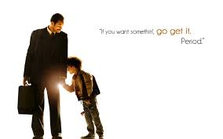
Whole Person Discipleship
Are you following Jesus
… as a father/mother/parent?
… as a wife?
… as a manager?
… as a neighbour?
… as a customer?
… as a pastor?
Notes:
Whole person discipleship is lifestyle evangelism – live your life in surrender to God and let your good works be the evidence that will attract others to Christ. As we live our rhythm we become a place where others encounter God

Slide 11
Whole Community Discipleship
Is your community different because you are following Jesus?
Do those around you see Jesus when they watch you?
Are you ‘salt’ and ‘leaven’ in the world?

Slide 12
Discipleship in the Congregation
Disciples pray with passion
Disciples worship
Disciples love the Church and serve her with energy and joy
Disciples give lavishly
Disciples hunger to learn more about their faith
Notes:
Discipleship has to take place at the congregational level. For this to happen –the atmosphere of fellowship, support in and outside of crises, worship, congregation’s spiritual climate, energy level, attendance at formation events such as Bible Study, mission and vision, base line, even what the congregation asks of its leaders, how we welcome and nurture each other; all of this must be of such that it invites into a nurturing space those who come to worship and serve Christ as a member of that community. The number of disciples in a congregation changes everything:

Slide 13
Discipleship in the Congregation
Disciples make use of learning opportunities given in a congregation (diocese) or faith community.
Disciples use their gifts and discern vocations. They clamour to recognize God’s call because they long to live it.
Notes:
Disciples evangelize because they have really good news to share.
Disciples share their faith with their children.
Disciples care about the poor and about issues of justice.
Disciples take risks for the Kingdom of God.
Sherry A. Wedell - Forming Intentional Disciples: The Path to Knowing and Following Jesus

Slide 14
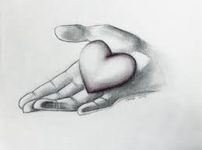
Everything for Jesus!
We can hold nothing back.
Just think for a moment about what you still need to give to Jesus in your life?

Slide 15
Use our Gifts in Discipleship
Each of us who is baptized is given gifts by and through the Spirit. Gifts are given not just to a few special Christians, or to individuals in specific religious communities or movements.
Notes:
The gifts we have been given are so endowed in order that we will be empowered by God to be channels of His love, mercy, beauty, compassion, truth, wisdom, healing, and provision for others.

Slide 16
Use our Gifts for Discipling
We have to be open to these gifts of the Holy Spirit, discerning them, and willingly exercise them for the sake of others as critical acts of obedience.

Slide 17
The Goal
Discipleship isn’t a sudden condition of spiritual maturity. It is a process of growing and learning as a student at the feet of Jesus. The goal of discipleship is a constant multiplication of disciples, which requires leadership
Deepen our own spiritual relationship with God
Evangelize our nation
Increase congregational membership
Notes:
Whoever studies under the tutelage of Jesus is a disciple no matter how much he/she has already grown.

Slide 18
The Goal
Deepen our personal relationship with God
Evangelize our nation
Increase congregational membership
Notes:
Jesus and the apostles didn’t leave discipleship growth up to chance. On the contrary, they intentionally, that is deliberately and purposely, nurtured others in their growth. We also can’t leave discipleship to chance, hoping that the believers will somehow grow.
Making disciples is important because it is the Lord’s chosen method of spreading the Good News of salvation through Jesus Christ. During His public ministry, Jesus spent more than three years making disciples—teaching and training His chosen twelve. He gave them many convincing proofs that He was the Son of God, the promised Messiah; they believed on Him, though imperfectly. He spoke to the crowds, but often He drew the disciples aside privately to teach them the meaning of His parables and miracles. He sent them out on ministry assignments.

Slide 19
Raising Disciples
OFFER multiple, overlapping opportunities for baptized and non-baptized people to personally encounter Jesus in the midst of his Church.
EXPECT CONVERSION - Plan for conversion.
LAY THE SPIRITUAL FOUNDATION through organized, sustained intercessory prayer.

Slide 20
Raising Disciples
The Early Church was intentional about the nurture of its members in living their whole daily lives in the imitation of Jesus. One approach was Catechesis -religious instructions given in preparation for the sacraments of initiation

Slide 21
Raising Disciples
“The ministry of the Laity is to represent Christ and His Church; to bear witness to Him wherever they may be; and according to the gifts given them to carry on Christ’s work of reconciliation in the world, and to take their place in the life, worship, and governance of the church.”

Slide 22
Discipleship Tools
The Sacraments of Initiation:
Baptism
Confirmation
Holy Eucharist

Slide 23
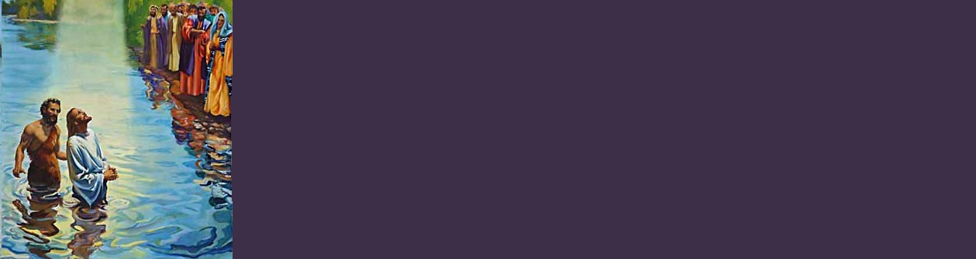
Discipleship Tools
The Sacrament of Baptism
… is the incorporation into a dynamic relationship with the living God. We welcome a new member into the Lord’s family ; membership wrought the Paschal mystery of Christ’s life, death and resurrection.
Notes:
Baptism Our preparation for baptism must be deliberate, and the belief of the church taught
God-Parents must be present for preparation and to be made to understand that their role is not to buy birthday and Christmas gifts for their god-children, but a god-given responsibility to nurture the child so that s/he will grow up rooted in love, nurtured in the faith

Slide 24
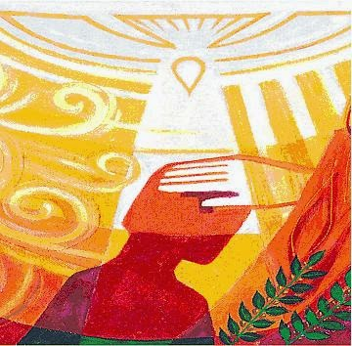
Discipleship Tools
The Sacrament of Confirmation
… serves as a decisive acknowledgement of personal union with Christ. … the public act in which the baptised person affirm Christian belief and are admitted into the vocational life
Notes:
Confirmation - is the public act in which the baptised person (including those baptised as babies) affirm Christian belief and are admitted into the vocational life of the church – it is not graduation. It is a public ratification of baptism which also serves as a definitive acknowledgement of our personal union with Christ. Confirmation is the charismatic manifestation of the Holy Spirit to live as a witness of Christ in the world and when the bishop lays hand upon the individual and anoints them in the midst of the congregation because the bishop is the symbol of unity for the Universal church, that laying on of hands tells the confirmed individual that s/he or his a missionary member of the Universal church

Slide 25
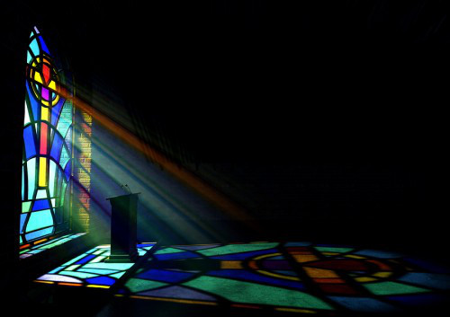
Discipleship Tools
The Holy Eucharist
… instituted by Jesus Christ during his Last Supper with his disciples in which he gave them bread and wine and commanded them to “do this in memory of me.”
Notes:
Holy Eucharist – In the Eucharist also we receive the benefits of the forgiveness of sins, the strengthening of our union with Christ and one another even as we are nourished in eternal life.
What I am suggesting is that we already have tools that may be used for deliberate discipleship = some of them we know them as sacraments, but we have to seek to understand them; we have to seek the meaning in them; we have to use them and by faith receive the spiritual benefits through them because.
We also have various liturgies of the church that are applicable to contemporary realities: How can we celebrate new birth; how can the Mother’s Union be more involved in the preparation for baptism
Mentorship of our youths (boys – get the BSA involved)
Leadership Training and Career Advancement Conversations and nurture –
and the nurture of the new child – so the celebration of new birth is seen as a thanksgiving for a miracle

Slide 26

Finally, discipleship is a great privilege. It should be taken and treated as such. The task of discipleship puts us in a position of honour as someone is trusting us to walk with them in advancing their relationship with God.
Notes:
You may not have all the answers, but you can learn about and draw closer to God together. You stand present in their joys and sorrows as you constantly point the to or keep God before their eyes.
Personal involvement by way of personal recommitment and renewal
We began with the use of Lenten Bible Study Resource to prepare us as individuals and in the discipling community
Follow up resource on discipling - booklet similar to the purple booklet that helps to guide discipling relationships
Ongoing training opportunities for the advancement of the Intentional Discipleship thrust…

Slide 27
Training
Training Workshops to include:
Sunday School Teachers
Youth
Young Adults
B.S.A
Mothers’ Union
Women’s Auxilary

Slide 28

Prayer for Intentional Discipleship
Heavenly Father, we thank you that you have awakened your church to hear again the call of our Saviour Jesus Christ to come to Him and learn from Him. Grant that as we say “yes” to discipleship, Your Holy Spirit will enable is so completely to commit all
Notes:
Let us pray the Intentional Discipleship prayer, written by Bishop Harold Daniel (Retired Bishop of Mandeville)

Slide 29
Prayer for Intentional Discipleship
areas of our lives to His service, that in our personal, family and church lives, our work, recreational and social lives, we would act as Jesus would have acted if He were in our place. In His name and for his sake we pray. Amen
Notes:
Let us pray the Intentional Discipleship prayer, written by Bishop Harold Daniel (Retired Bishop of Mandeville)

