Slide 1
Diocese of Jamaica & The Cayman Islands Islands Intentional Discipleship and Disciple-Making Consultation Welcome

Slide 2
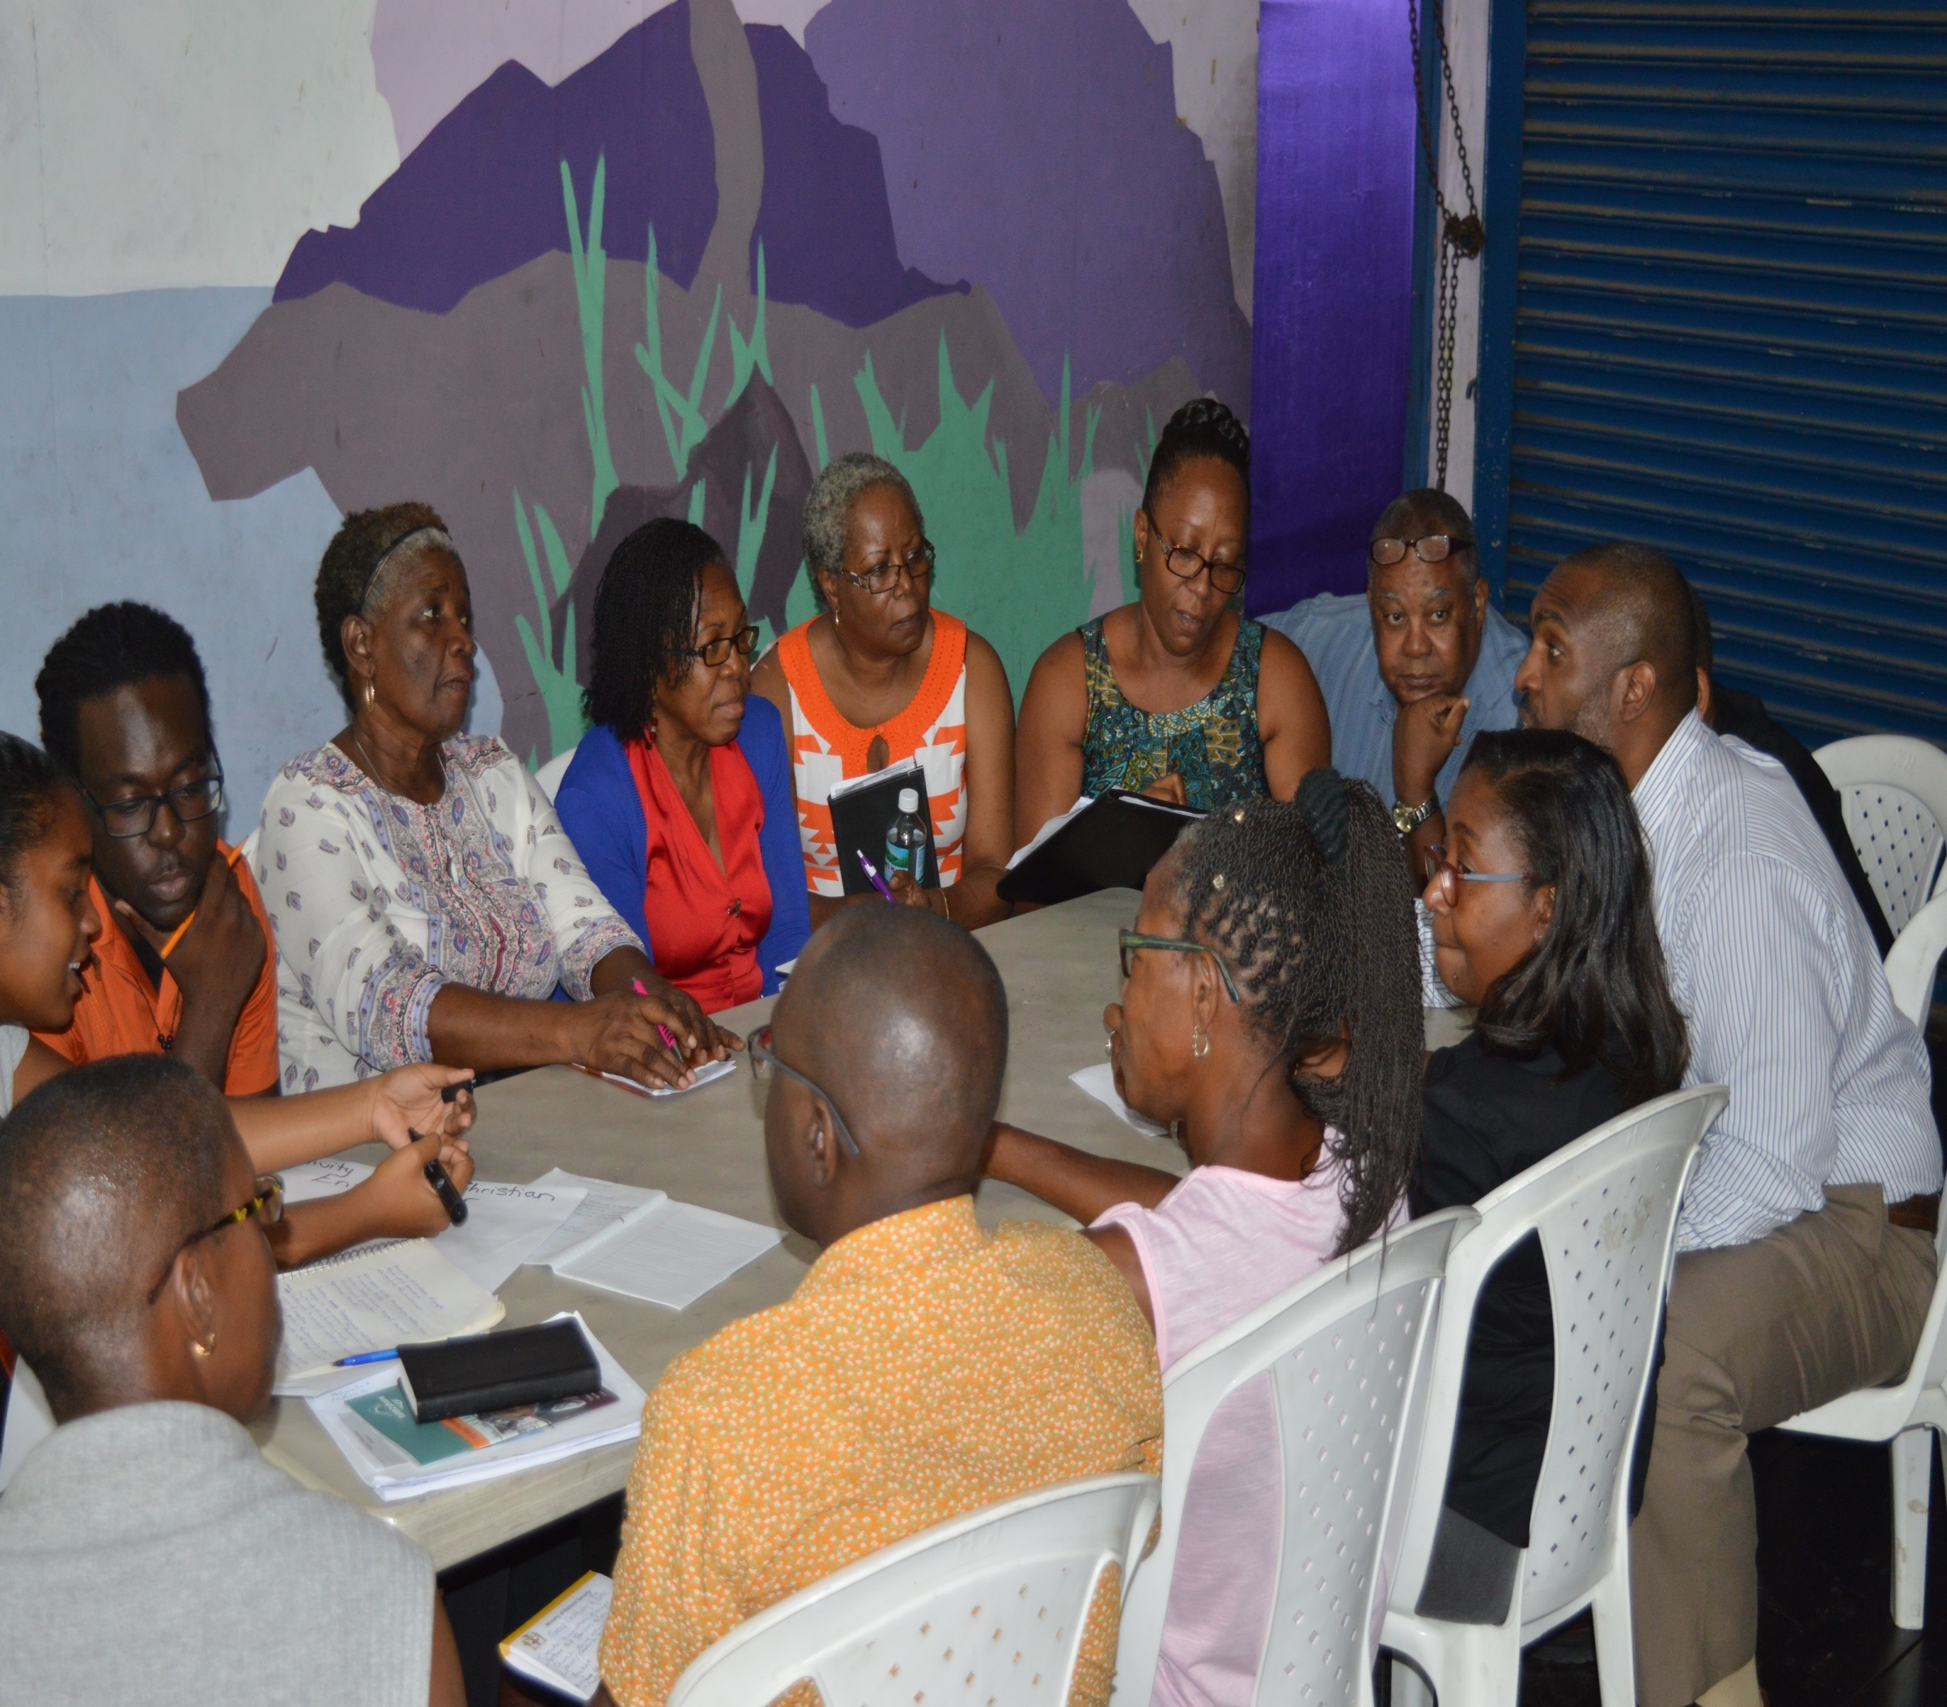
Study together

Slide 3
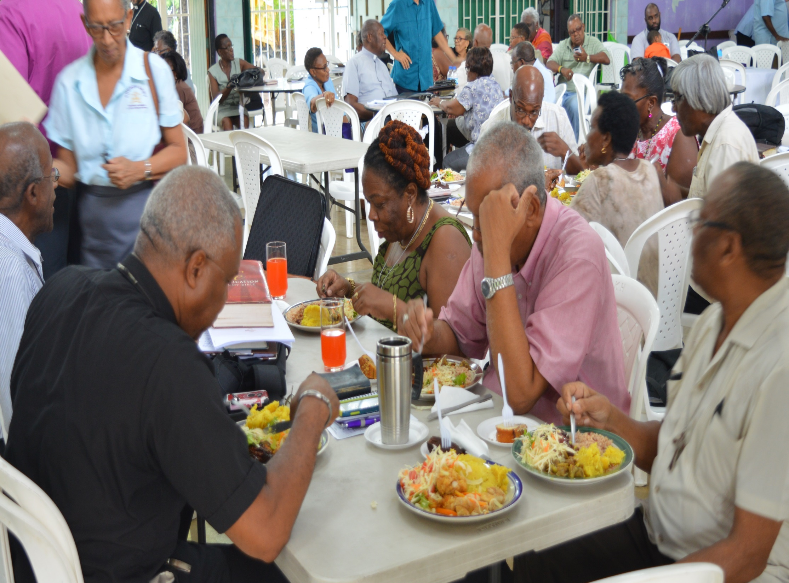
Eat together

Slide 4
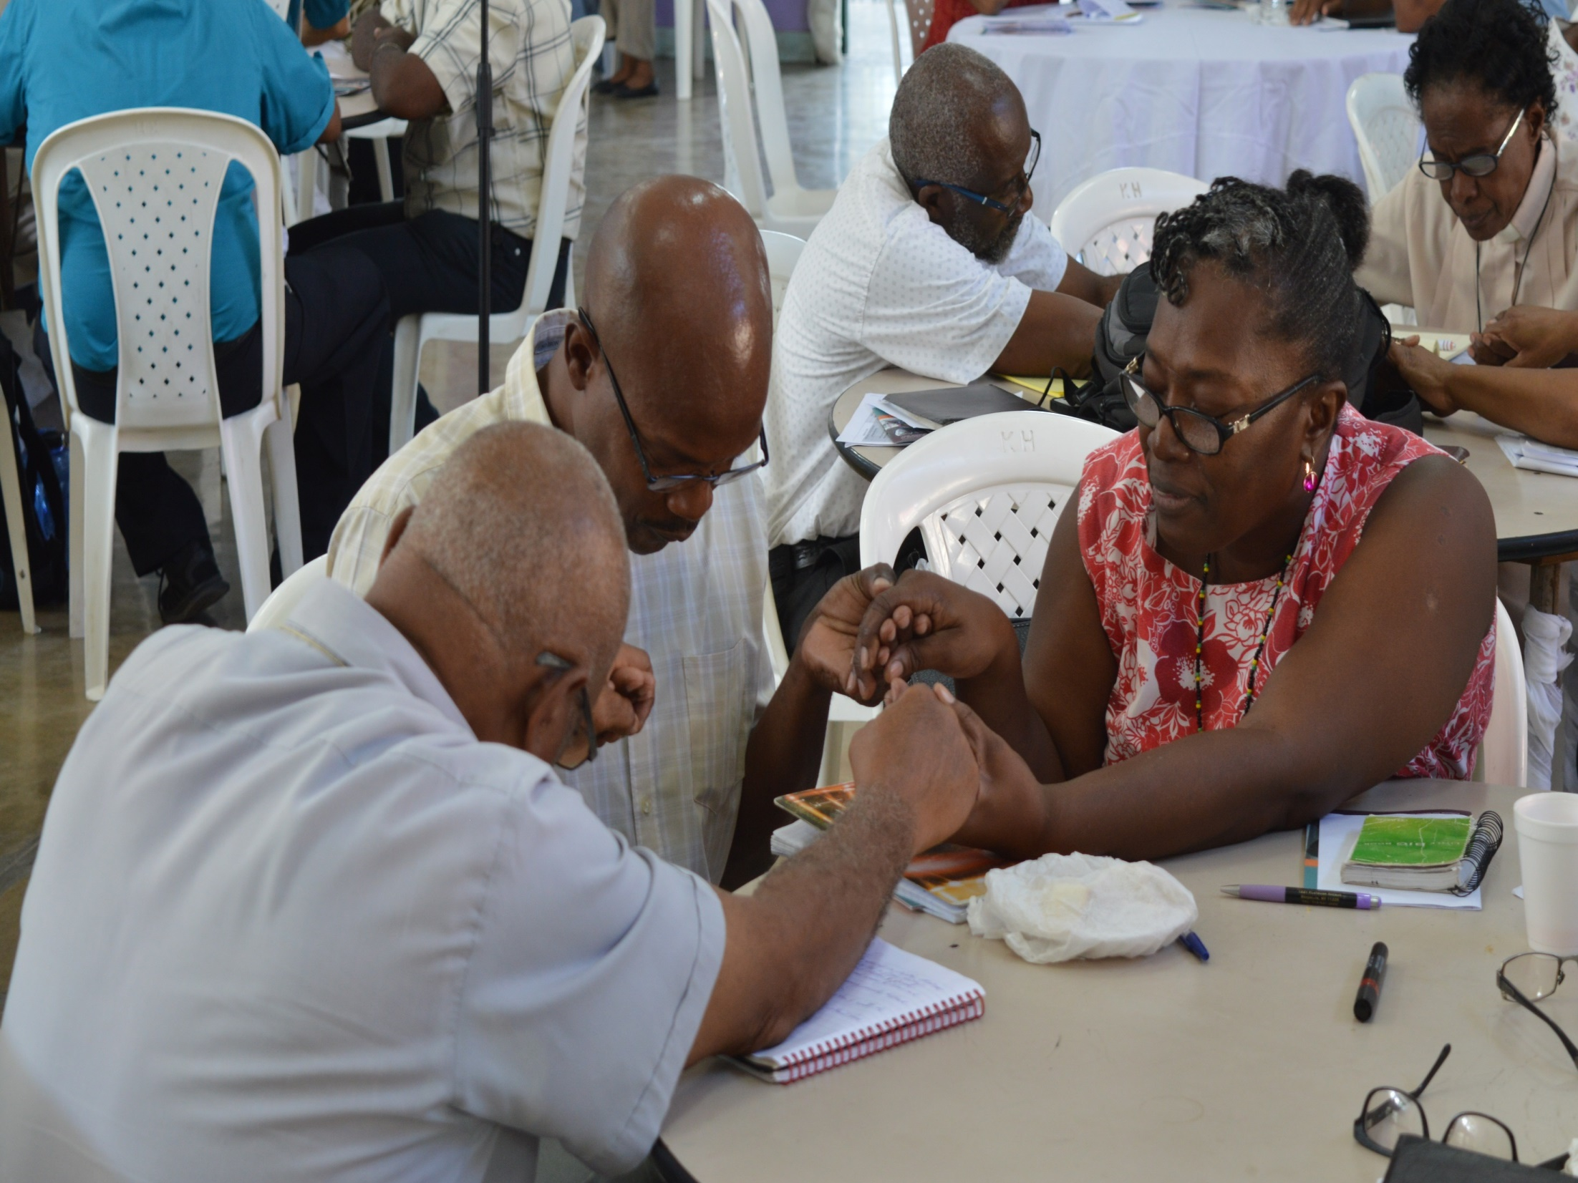
Pray together

Slide 5

What is Faith2Share?
An international
network of
mission
movements
.

Slide 6

Faith2Share is committed to:
• Discipleship
• Collaboration
movements
• Leaders
.

Slide 7

Discipleship and Disciple-making in the Anglican Communion
.gl

Slide 8
Discipleship is for the Whole-life
.

Slide 9
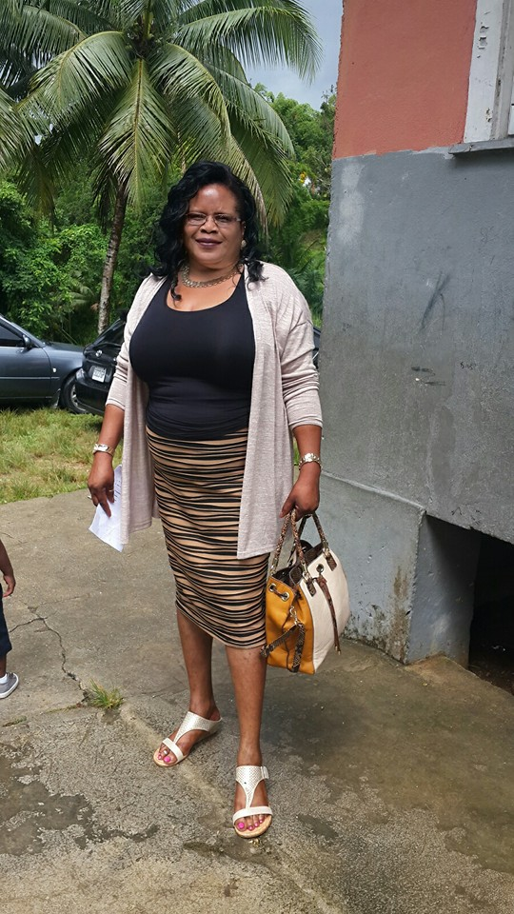
What is Whole-life Discipleship?
Whole Life
Whole Time
Whole Person
Whole Community
Jesus-shaped life JSL
.

Slide 10
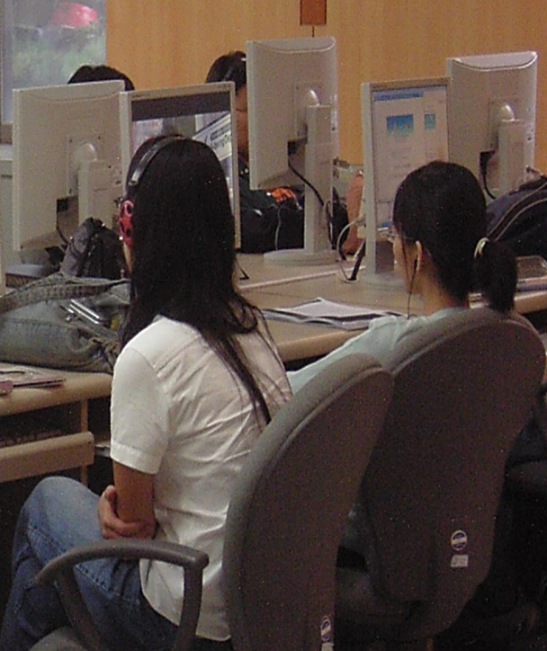
Whole Life Discipleship
No part-time Christians
Do you follow Jesus at work?
What about when you are relaxing?
Is Jesus just for when you need help?
Discipleship is for eternity!

Slide 11
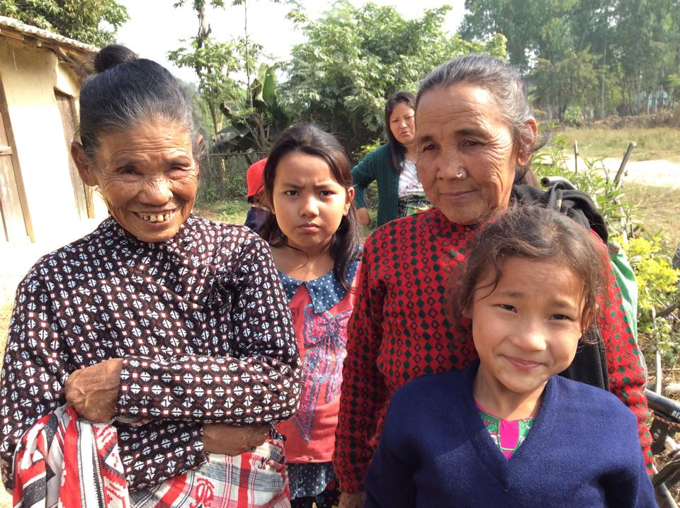
Whole Time Discipleship
Not just for Sundays
Not just when you choose
Even when you are with friends
who do not follow Jesus
When you are alone and nobody
can see you
Even when you are sleeping!

Slide 12
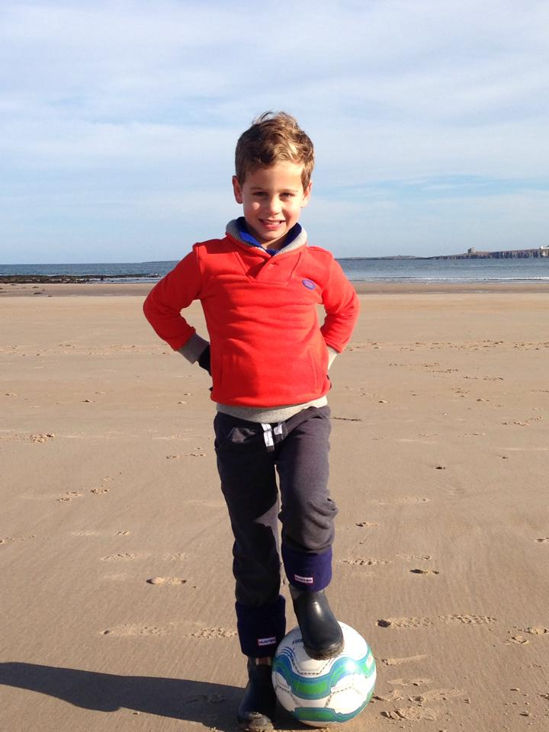
Whole Person Discipleship
Are you following Jesus
… as a father?
… as a wife?
… as a manager?
… as a neighbour?
… as a customer?
… as a pastor?

Slide 13
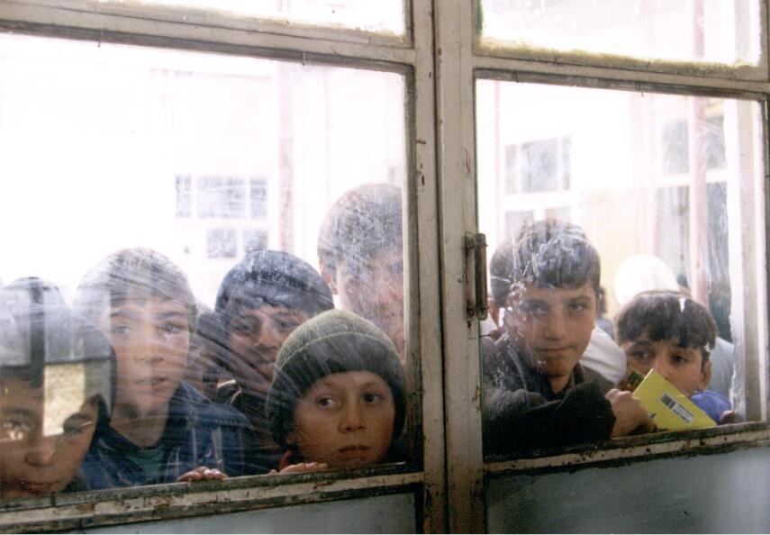
Whole Community Discipleship
Is your community different because you are following Jesus?
Do those around you see Jesus when they watch you?
Are you ‘salt’ and ‘leaven’ in the world?

Slide 14
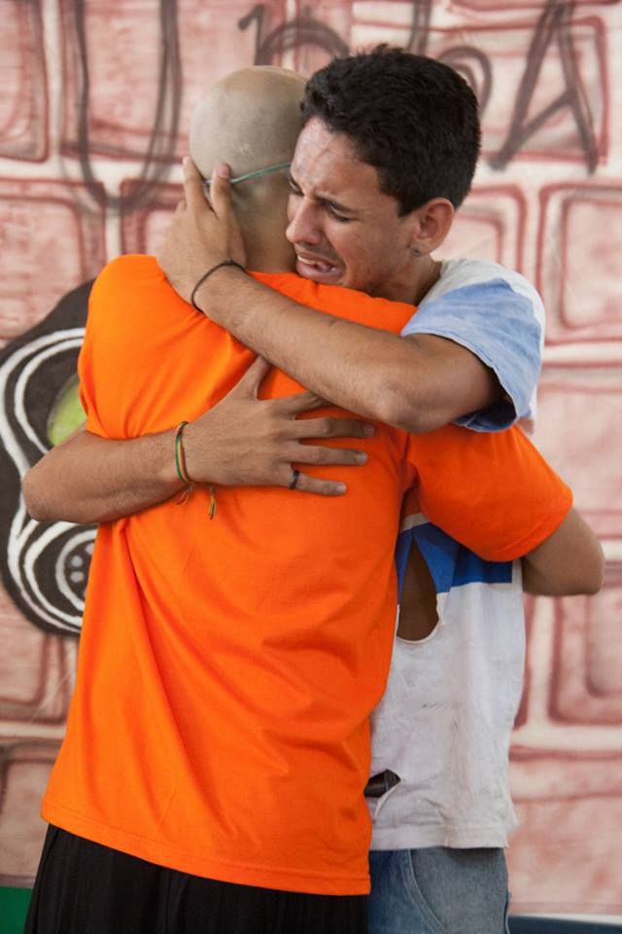
Everything for Jesus!
We can hold nothing back.
Just think for a moment – What do you still need to give to Jesus in your life?

Slide 15

Intentional Discipleship: Purpose of these two days
To equip each of us,
As leaders to
grow and encourage
Intentional disciples in your parish or context

Slide 16
Trainininers
YouDiscipleship is about
Multiplication
.

Slide 17
The tale of three good Christians

Slide 18
The tale of three good Christians
The Evangelist
The Disciple-Maker
The Master

Slide 19
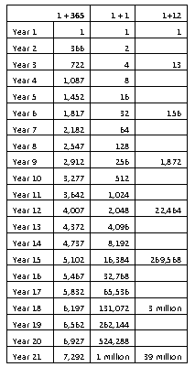
.

Slide 20
Who was the master?
The Evangelist
The Disciple-Maker
The Master

Slide 21
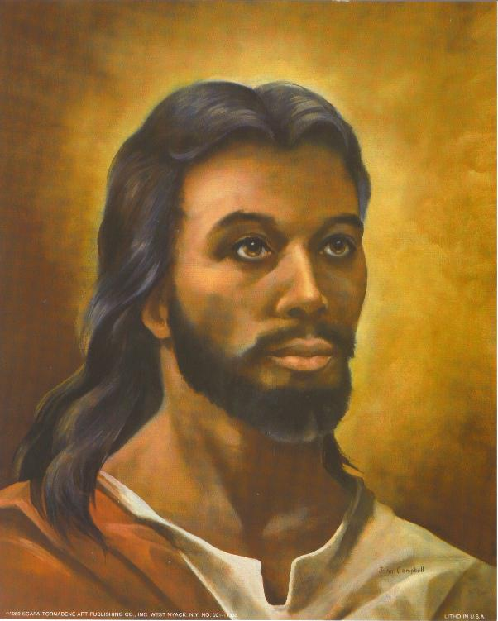
Who was the master?
The Evangelist
The Disciple-Maker
The Master

Slide 22
Questions to Ponder

Slide 23
Who discipled you?

Slide 24
Who is discipling you NOW?

