Slide 1




Diocese of Jamaica & the Cayman Islands
Sunday School Teachers’ Lesson Planning Guide
Produced by: Mrs. Liz Smith and Rev. Douglas Barnes 2017
Notes:
Pen to the first 48 who arrive

Slide 2




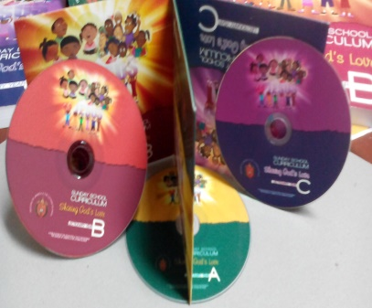

Using the Sunday school curriculum
Notes:
1. A Curriculum is important for formal learning and is at the “heart” of any learning.
2. Using a curriculum has many benefits, such as providing a structure for an educational course and having an end goal that teachers set for their students to reach.
3. Each of us are on the same page and work towards the same thing – creates unity

Slide 3
The Sunday School Curriculum
The Sunday School Curriculum is a formal compilation of lesson content, activities and songs, based on the Lectionary readings used in the Anglican Church. The guide covers specific liturgical themes and seeks to engage children between 2 – 16 years old, during a period of study, learning, spiritual nurture and preparation to live as Christians in the world.
Notes:
Allow for conversation

Slide 4
Benefits of A Sunday school curriculum
A curriculum is important for formal learning and is at the “heart” of any learning.
Using a curriculum has many benefits, such as providing a structure for an educational course and having an end goal that teachers set for their students to reach.

Slide 5
Purpose of the Sunday school curriculum
The Curriculum –
helps to keep all learners across the diocese “on the same page” as work towards the same thing – creates unity
Create deep thinkers
Engage learning with meaning and purpose

Slide 6
Purpose of the Sunday school curriculum
Helps to equip the teacher
Ensures consistency in content across the Diocese
Establishes commitment by all stakeholders i.e. church leaders, teachers, parents and students
Encourages follow-up study
Better engages students
Enables a journey of spiritual growth

Slide 7
Purpose of the Sunday school curriculum
Provides potential lesson plans for each day of the Church’s calendar year
Aligns the lessons in keeping with those of the Church’s calendar
Demonstrates preparation of material that is age appropriate
Ensures that your delivery is in line with the Church’s expectations
Notes:
Anyone who doesn’t use the guide? Ask who uses the Diocesan Curriculum Guide, any other guide.

Slide 8

Lesson planning

Slide 9
LESSON PLANNING
Creating
Applying
Evaluating
Analysing
Understanding
Recalling
The Diocese of Jamaica and the Cayman islands has made it possible for all of these areas of learning to take place by providing the Sunday School Curriculum Guide.

Slide 10

LESSON PLANNING
The Diocesan Curriculum Guide provides lesson plans for all age groups but it is not prescriptive. That means, the Guide does not hold you to teaching the material exactly as shown in the book.
LESSON PLANNING

Slide 11
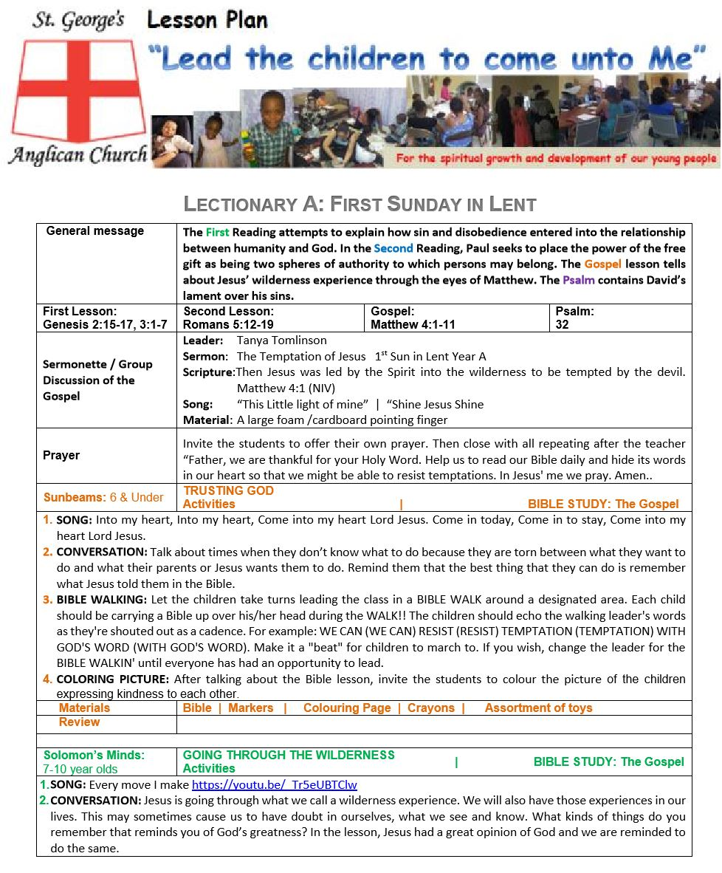
LESSON PLANNING
One way that adaptation may be done is by choosing to design a Lesson Plan.
The picture shown here shows the lesson plan used by our sister congregation, St. George’, in Grand Cayman.
A Lesson Plan, such as the one shown, is prepared for the Sunday School each week.
LESSON PLANNING

Slide 12
LESSON PLANNING
A banner was designed to give an identity to Sunday School. The banner bears:
The Church’s logo
Their motto and overall objective /purpose
Pictures of some of their students
LESSON PLANNING
The type of document

Slide 13
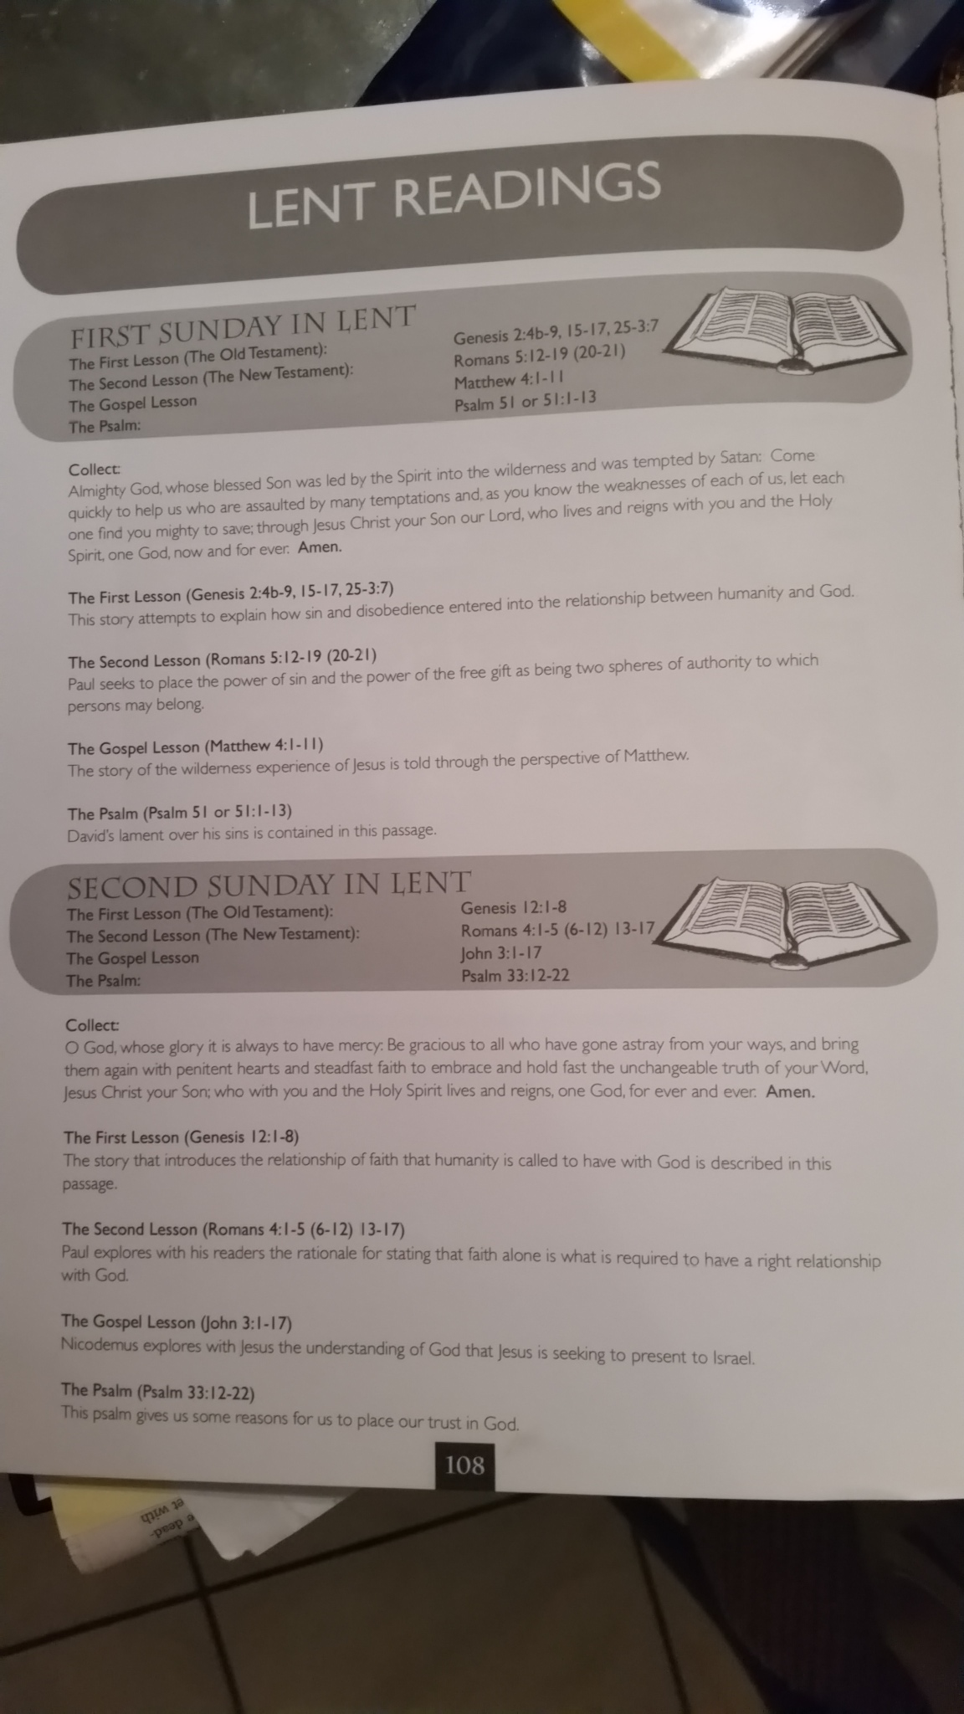
LESSON PLANNING
The Lectionary year and specific Sunday, in keeping with the Church’s calendar, are placed at the top of the page. Lessons for each Sunday and a description of each are also provided. All of this information is derived from the Diocesan Curriculum Guide.

Slide 14
LESSON PLANNING
LESSON PLANNING
Brief descriptions of the readings are found at the beginning of each group of lessons organized by the Liturgical Season.

Slide 15


LESSON PLANNING
In some churches, Sunday School begins with a Devotional led by an assigned Team Leader for the day. This is most appropriate when Sunday School begins at the same hour that the (adult) community services begin. All other Sunday School teachers ensure the appropriate student attendance by sitting with them and supporting the leader as required.
In other congregations, Sunday School begins after the gospel is proclaimed and the priest offers a mini-sermon or reflection to the children, blesses them and sends them off with their teachers.

Slide 16

In other places Sunday School is held before or after the community service and as such, more can be shared and learned.
Due to the dynamics of some Sunday schools, all students may be in one class. In this case the whole group may be given a name as well (for example, “Kingdom Soldiers”).
Material covered in this setting has to be at a level that involves every one, as much as possible, so that no one gets left behind. When it is craft (or activity) time then different activities may be given to the different age groups

Slide 17

LESSON PLANNING
The Devotional time should provide an opportunity for all members of the Sunday School family to talk about the day’s lesson(s). The mini-sermon/reflection for the particular Sunday may be taken from www.semons4kids.com or from one of the various available online resources.
http://www.sermons4kids.com/

Slide 18
LESSON PLANNING
Team Leader for the day delivers the sermonette.
The Sermon promotes expected behaviour(s).
The Scripture is usually the Gospel lesson.
The song may be the one set in the Curriculum, an appropriate one of the students’ choice or one you wish to teach them.
LESSON PLANNING:- devotional
Required material is listed to help prepare for Sunday School.

Slide 19
LESSON PLANNING
Two or three students are invited to individually pray aloud, followed by a prayer led by the Team Leader for all to repeat. The above prayer was part of the sermonette for this Devotional.
LESSON PLANNING:- prayer
http://www.sermons4kids.com/

Slide 20
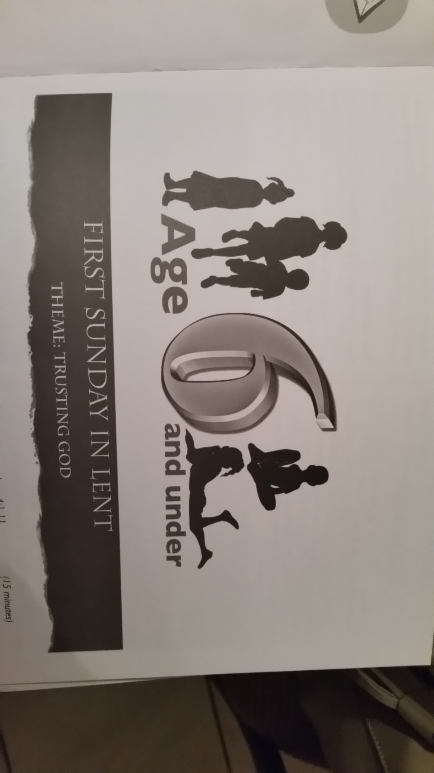
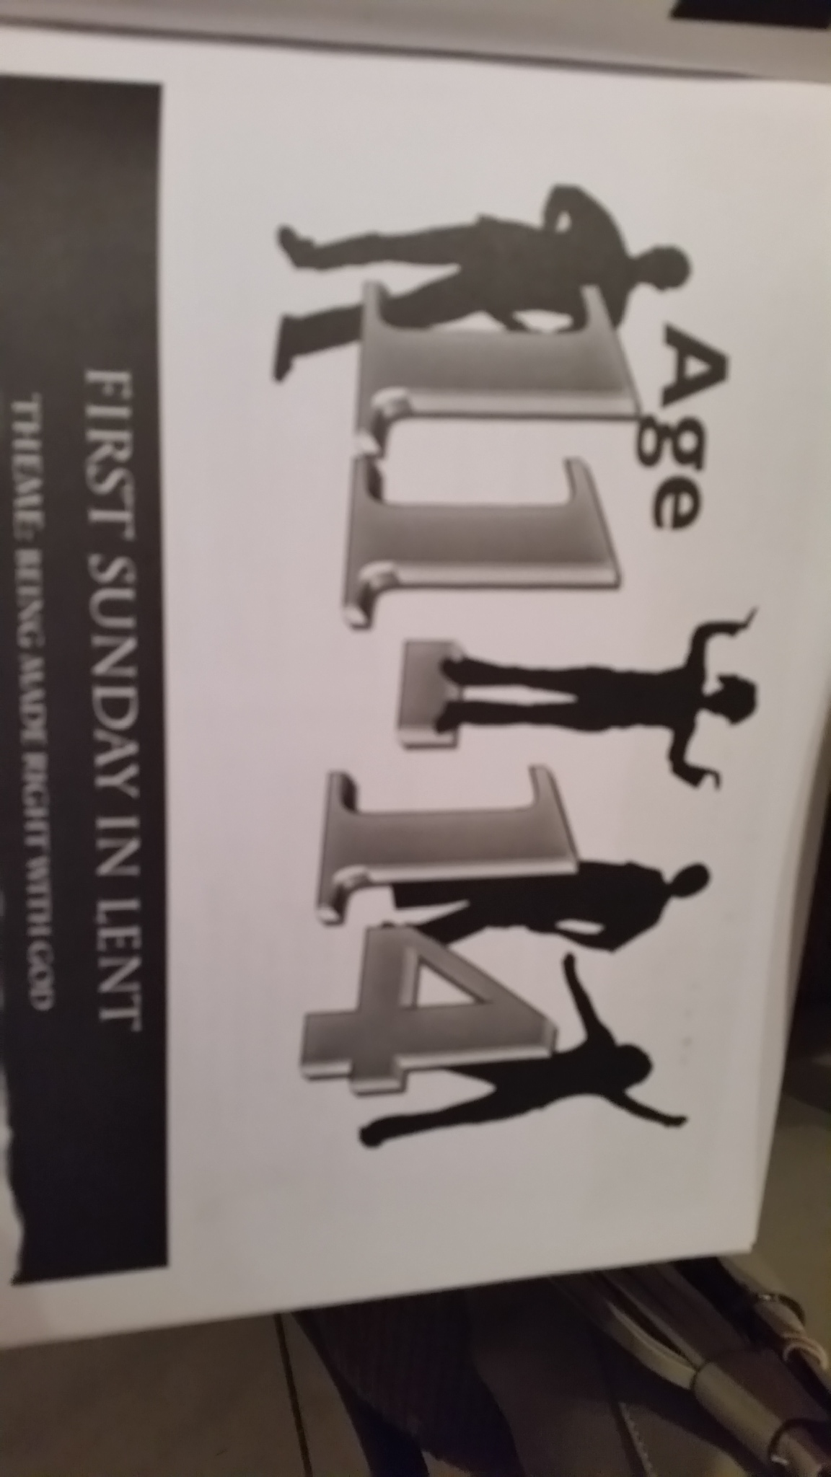



LESSON PLANNING
Using age group organization for Sunday School, you may give class names, which gives them an identity and a goal to focus on. St. George’s uses these:
6 and under Sunbeams (Noah’s Ark for 0-2)
7-10 years Solomon’s Minds
11-14 years Jesus’ Disciples
15-16 (and over) Fruits of the Spirit
See pages 111, 117, 125 and 132 of the CG
LESSON PLANNING:- groups

Slide 21

LESSON PLANNING
Take note that the name, “Fruits of the Spirit”, does not discount the Fruit of the Spirit as one that bears all of these attributes but that within each member of the Sunday School (15-16+ year olds) has a characteristic that stands out above the others. So the underlying goal for this age group is to identify and nurture the good attributes, especially since children at this age group wrestle with identity issues and are at the searching phase of faith development.
LESSON PLANNING:- fruits

Slide 22
LESSON PLANNING
Planning for each group
6 and under Sunbeams (Noah’s Ark for 0-2)
7-10 years Solomon’s Minds
11-14 years Jesus’ Disciples
15-16 and over Fruits of the Spirit
LESSON PLANNING:- groups

Slide 23
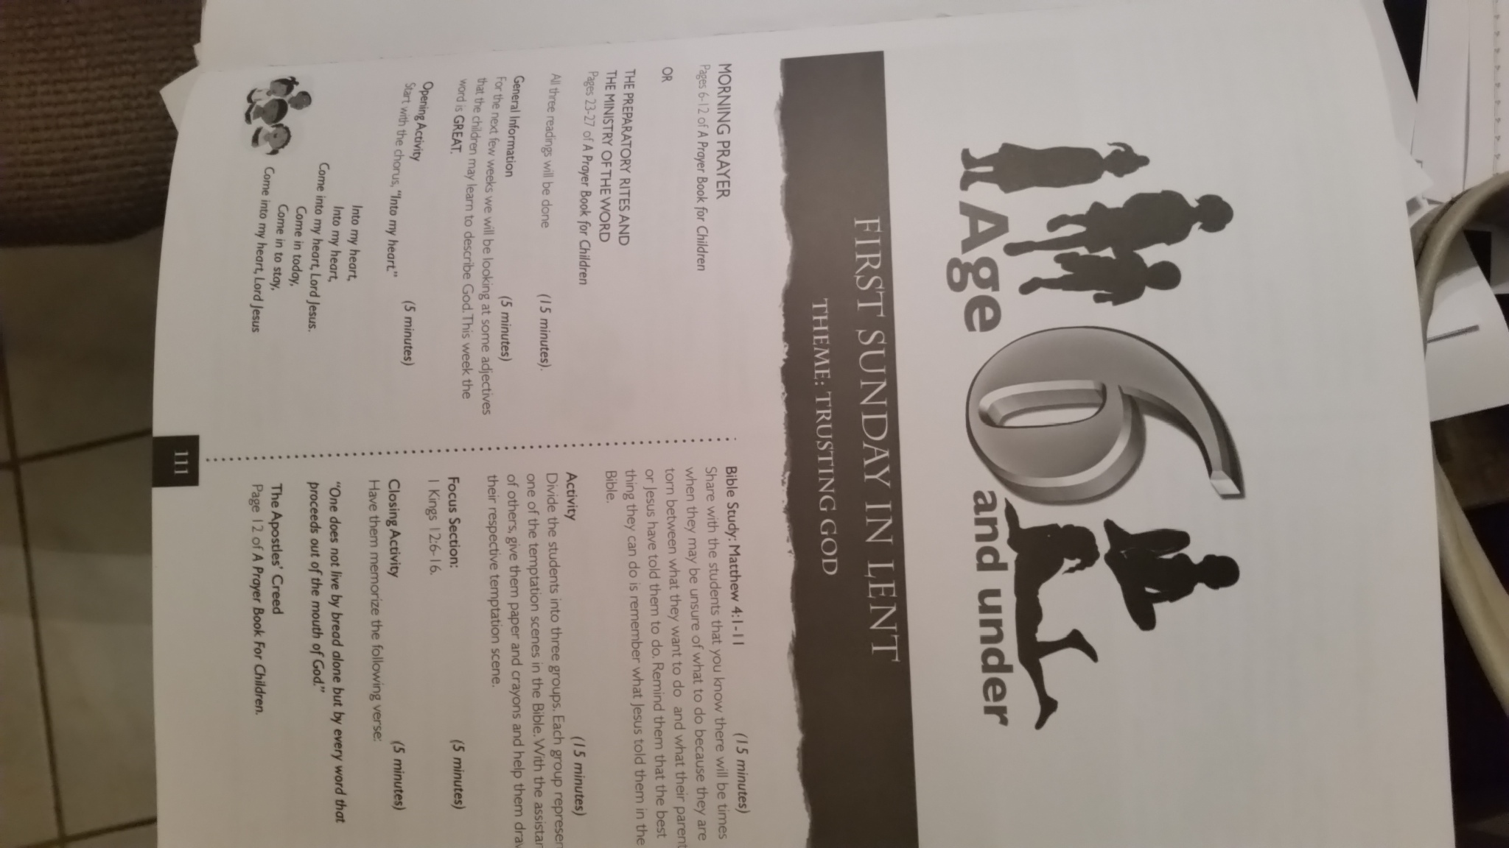
LESSON PLANNING
A theme, song and conversation are suggested in the Curriculum Guide
LESSON PLANNING:- sunbeams
Activities from Sermons4kids

Slide 24
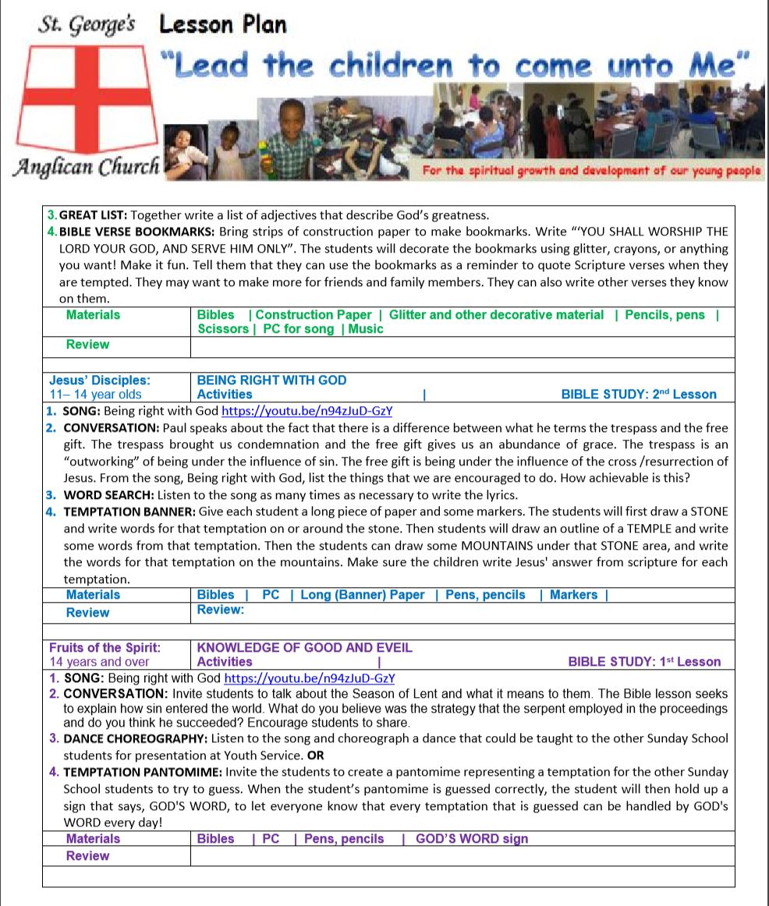
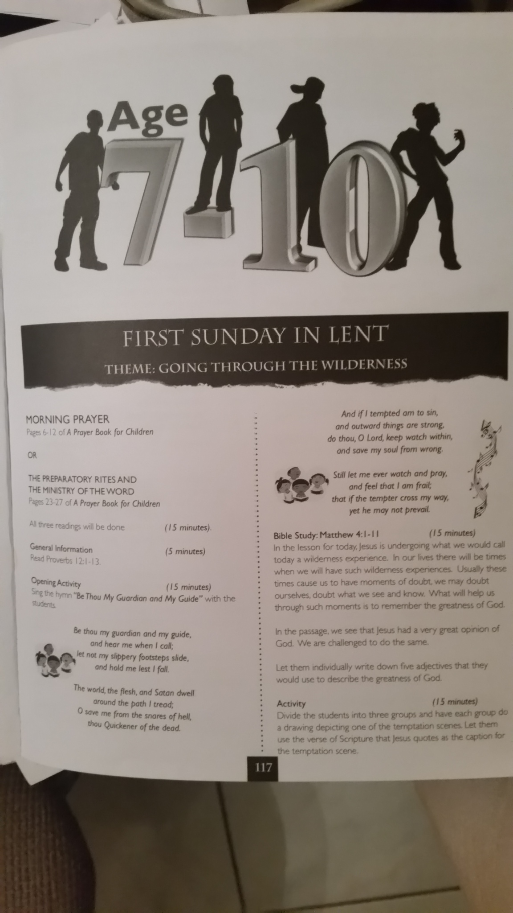
LESSON PLANNING
Song known by the students
Theme and Conversation as per the Bible Study
LESSON PLANNING:- Solomon’s minds
Activity 3 from the CG
Activity 4 from Sermons4kids

Slide 25
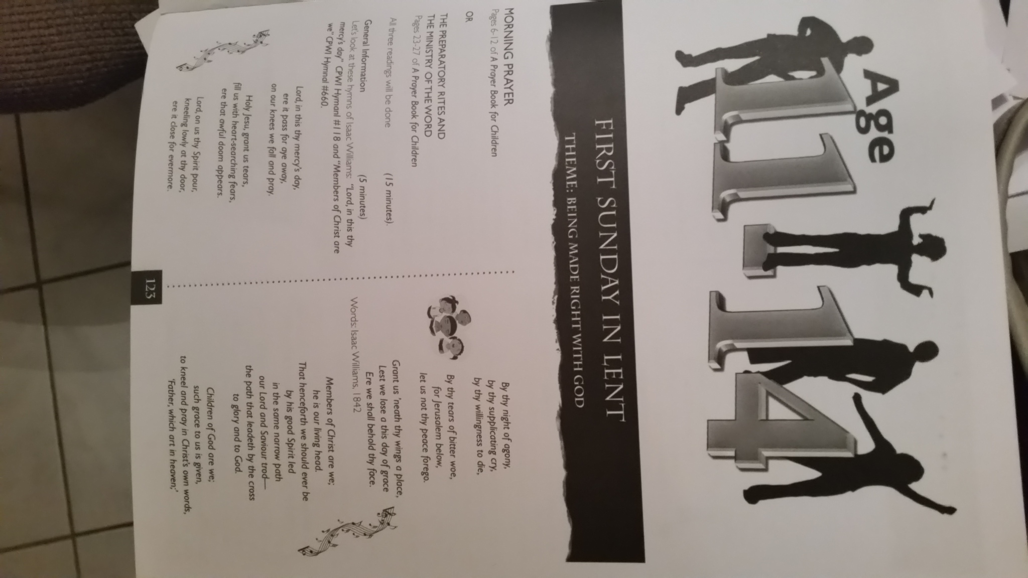
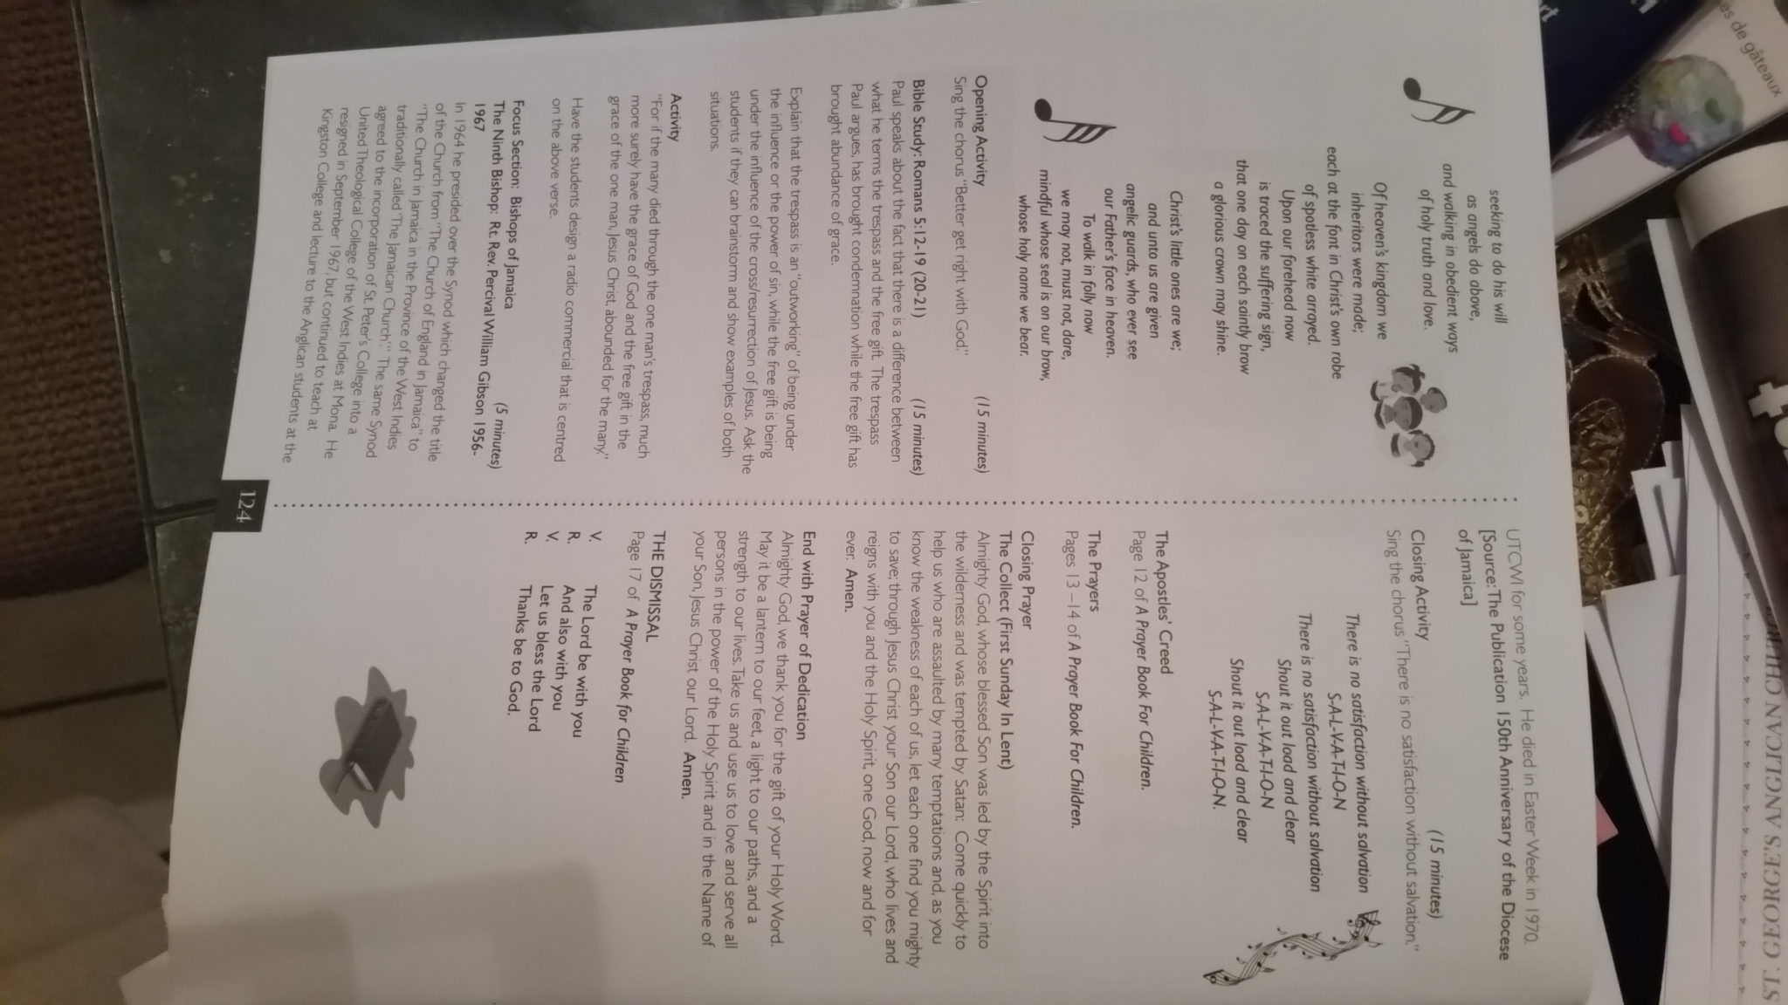
LESSON PLANNING
Theme, Song and Conversation as per the Curriculum Guide
The picture of page 123 in Curriculum Guide to show the theme
Page 124 to show Song and Bible Study
LESSON PLANNING:- Jesus’ disciples
Activities from Sermons4kids

Slide 26
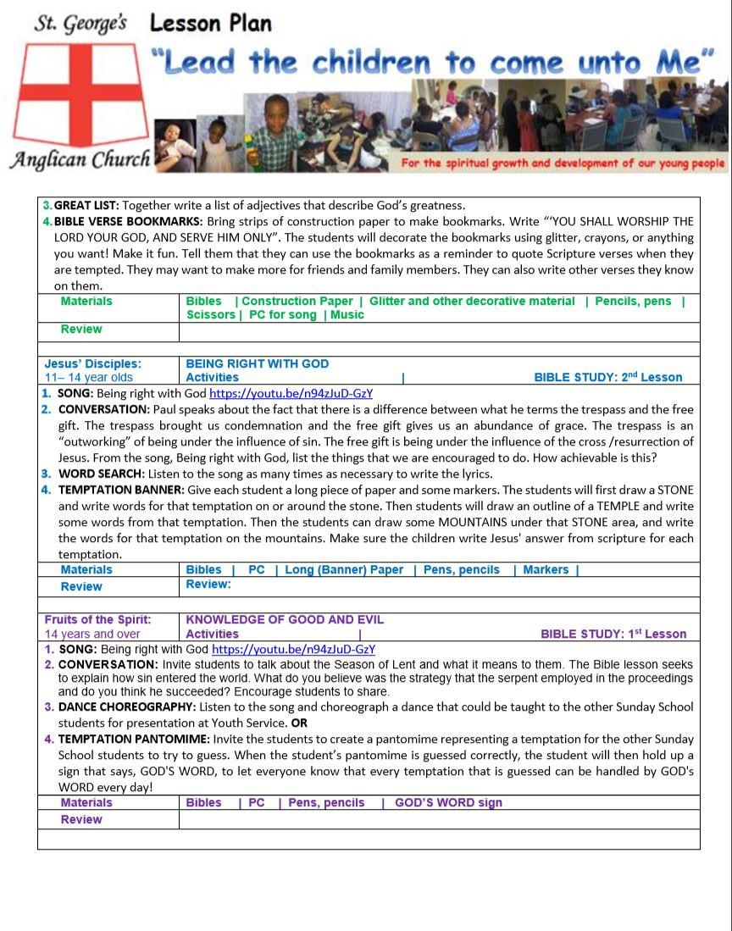
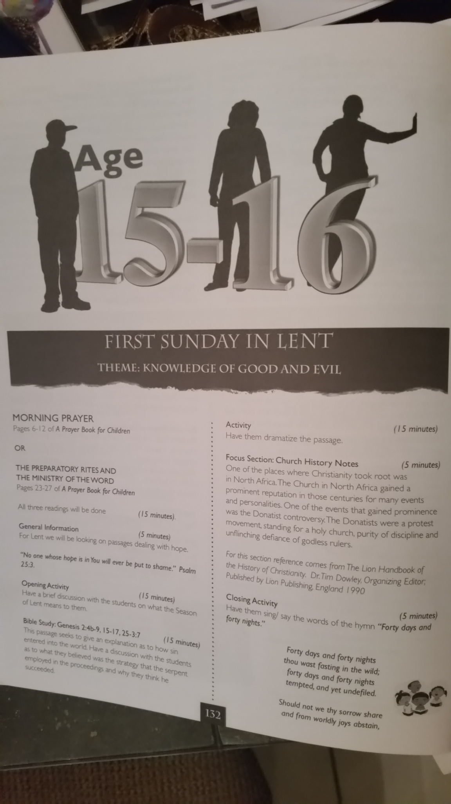
LESSON PLANNING
Theme and Conversation from the Curriculum Guide
Song for Jesus Disciples group in the Curriculum Guide
Activity 3 from Sermons4kids
LESSON PLANNING:- fruits of the spirit
Activity 4 amended from the Curriculum Guide

Slide 27

LESSON PLANNING
Plans for all groups list required material and an opportunity to provide comments of the lessons by way of a Review. Group plans are colour-coded for ease of reference
LESSON PLANNING:- materials and review

Slide 28
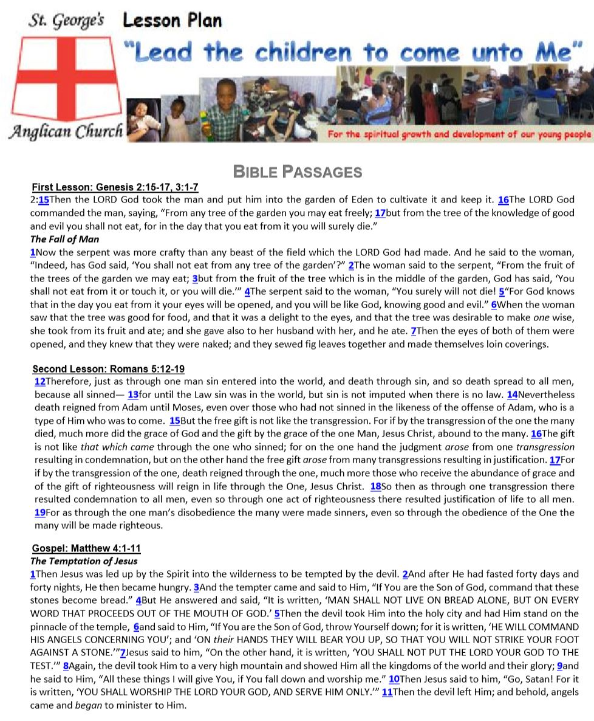
The Bible Lessons assigned for the day are also included in the Lesson Plan (pg 108)
LESSON PLANNING:- bible lessons

Slide 29
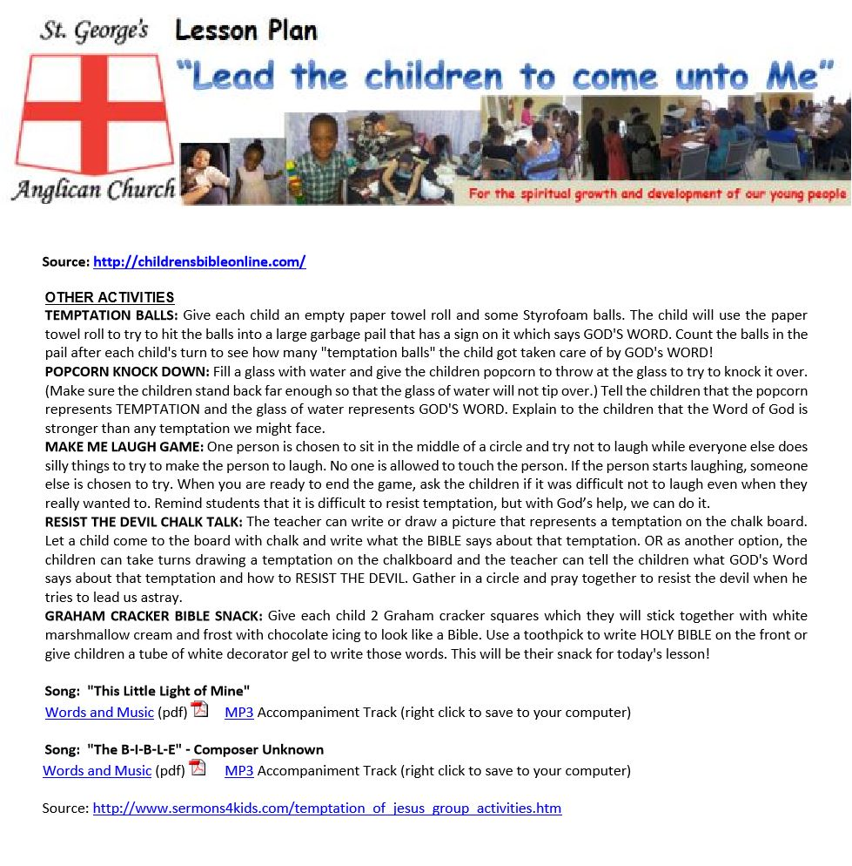
LESSON PLANNING
http://www.sermons4kids.com/
Other activities are usually derived from online resources but may also be found in books or other sources.
LESSON PLANNING:- other activities

Slide 30
LESSON PLANNING
The Diocesan Curriculum Guide and SGAC lesson plans are just two of many formats that may be used. Feel free to design your own and share with the rest of us.
LESSON PLANNING:- other activities

Slide 31

Notes:
End

